Slide 1
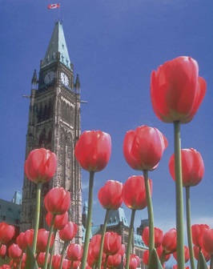
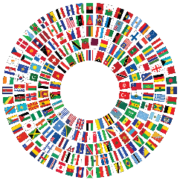
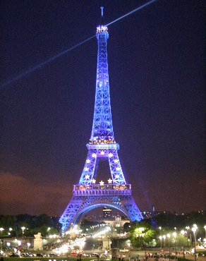
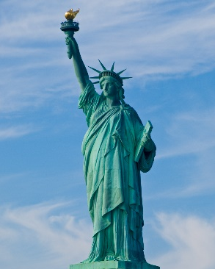
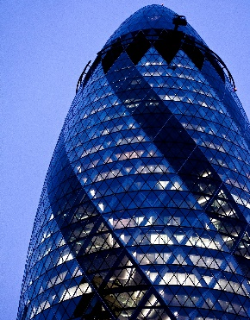
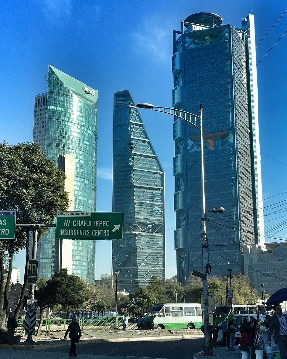


Harvard University Global System™
1
4
User Testimonials from Innovators: CEOs, Policy-Makers,
Team Leaders, Scientists, Engineers and Executive Assistants
5
In Business, Governments, NGOs, Trade Unions and Philanthropies
2
Who Applied the System to:
Save Thousands Lives; Reduce Serious Injuries;
Tackle Climate Change, Inequity, Injustice and Conflict;
6
Mobilize, Build, Coach and Retain Outstanding Teams;
Harness the Power of Strategic Thinking, Collaborative Innovation,
Technology, Intelligence and Negotiation to Discover Novel Options;
3
Secure the Stakeholders’ Engagement; Build Reliable Allies;
Manage Small and Multibillion-Dollar Projects Worldwide;
7
Build Trust; Excel in Safety and Customer Service
and Outpace the Competition.
™
Image numbers refer
to intellectual-property
attributions (see last slide).
.
.
The Professional Development Institute® PDI Inc.
Canada, USA: 1-800-HARVARD ● www.eharvard.org

Slide 2

2. THE INNOVATION FUNNEL:
AN ILLUSTRATION of “INVENTION”,
THE FIRST VARIABLE of THE FUNNEL
Important
The contents herein are for personal use. The user acknowledges
that they are protected by national and international-copyright laws.
No one is authorized to sell, rent, license, edit, modify, copy or display excerpts
of this video in a publication, a meeting, a conference, an educational or a training session
without the written permission of The Professional Development Institute PDI Inc.
You are welcome to comment, share or post, in your website
and social media, this presentation’s hyperlink: www.eharvard.org.
At rsvp@eharvard.org, we welcome your comments, questions, training,
licensing requests and other arrangements for presentations
not authorized under this agreement.
TM
Testimonials from Users
Harvard University Global System™
The Professional Development Institute® PDI Inc.
www.eharvard.org ● © Alain Paul Martin, 2023. All rights reserved

Slide 3
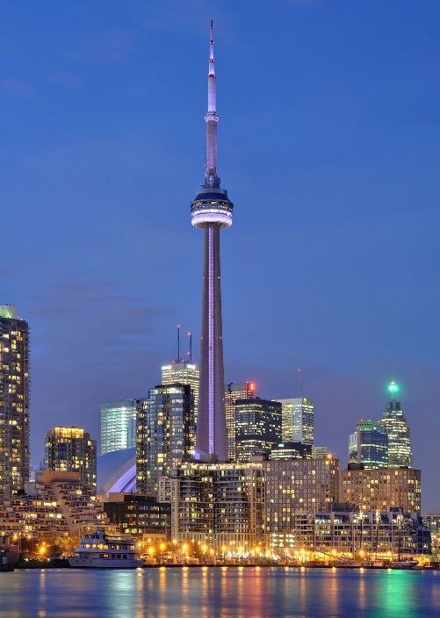
Testimonial from SKANSKA, the First Global Firm Applying the Global-Method™
That Is the Foundation of Harvard University Global System™
“Dear Mr. Martin, We are pleased to inform you that
we have now been applying the Global-Method’s approach,
in project planning for almost two years, in several projects
varying in size from a million-dollar to multi-billion dollar projects.”
Signed by two corporate vice-presidents
SKANSKA AB, Stockholm, Sweden
“[A] world leading project-development and construction group”, SKANSKA is today
“the greenest contractor in the world” and “the first to implement ISO 14000 globally”.
SKANSKA built the iconic Harvard’s new Art Museum, New York’s Second-Avenue Subway
line, MetLife Stadium, London’s Gherkin, Lund’s European Spallation Source, the world’s
most-modern research facility and
Toronto’s CN Tower. See next slide for illustrations.
SKANSKA’s executives and project leaders took Alain Paul Martin’s workshops in Atlanta and Stockholm. Then, SKANSKA anchored and supported PDI digital strategy and
software development. After using the software in its Swedish headquarters
and abroad; the firm distributed it in Finland, Germany, Norway, Sweden
and the United Kingdom, among other countries,
as the exclusive European distributor.
CN Tower, Wikipedia Commons
Wladyslaw Sojka.
www.sojka.photo
TM
Testimonies from Users
Harvard University Global System™
The Professional Development Institute® PDI Inc.
www.eharvard.org

Slide 4
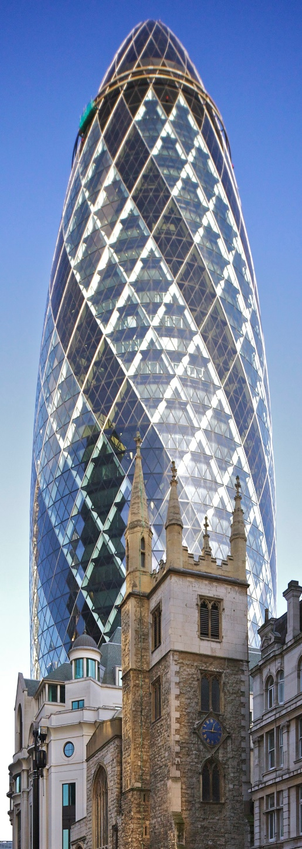
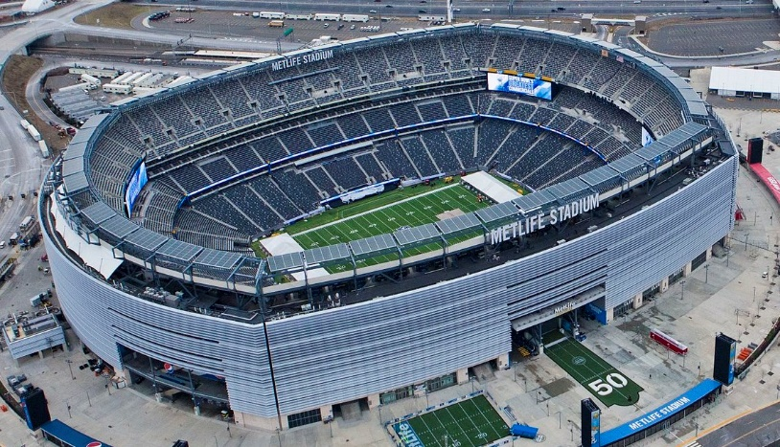
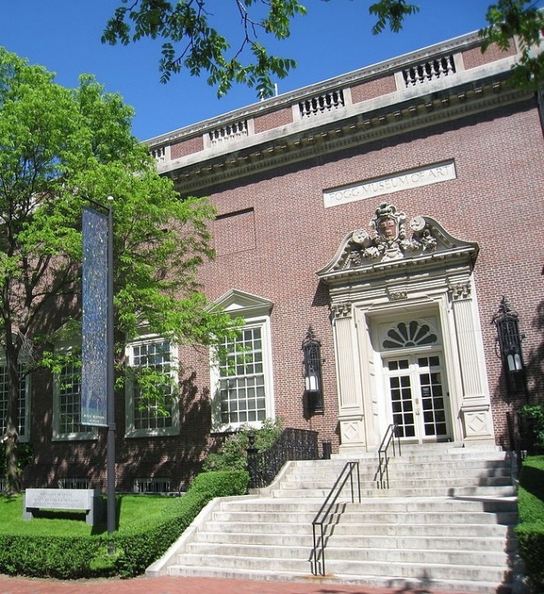
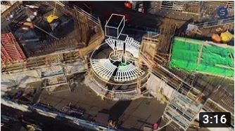
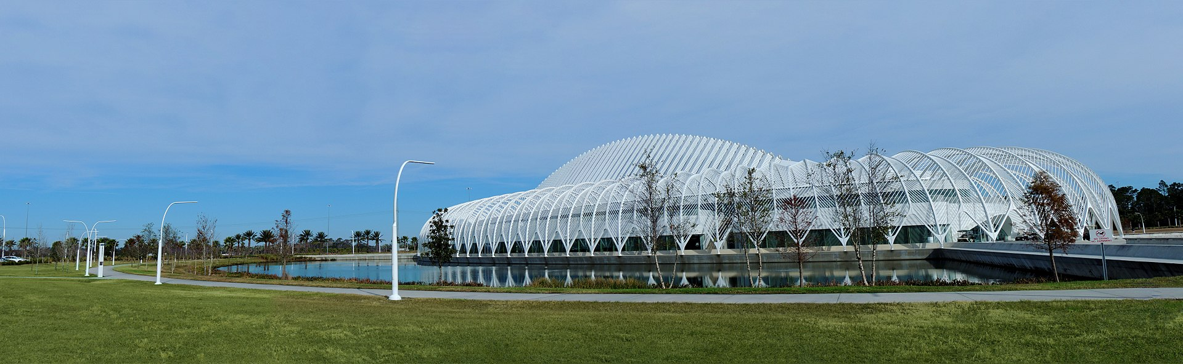
SKANSKA Today’s Iconic Achievements
MetLife Stadium on budget and 5 months
ahead of schedule. https://youtu.be/2PVsrzmMres
Cropped Photo: Anthony Quintano, (Wikimedia Commons)
National Museum, Stockholm
Harvard University’s Biology Research Infrastructure facility
eBay Project Topaz
2nd Ave. Subway, New York
World-Trade-Center
Transportation Hub, New York
Heron Tower, London
Harvard University’s Art Museum
Lund’s European Spallation Source (ESS)
the World’s most-modern research facility
www.youtube.com/watch?v=2bYWpGxHEak
Cropped Photo: Daderot (Wikimedia Commons)
Florida Polytechnic University
Skanska’s video: https://youtu.be/QIi7b_OBtgw
The Gherkin, London
https://youtu.be/FqibkzSPgNA
TM
Cropped Photo: by Ziggymarley01 (Wikimedia Commons)
https://en.wikipedia.org/wiki/Florida_Polytechnic_University
The Professional Development Institute® PDI Inc.
www.eharvard.org

Slide 5
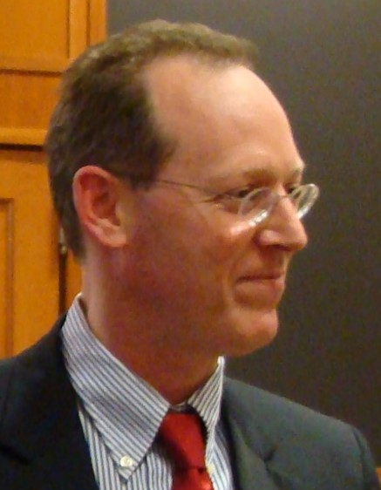
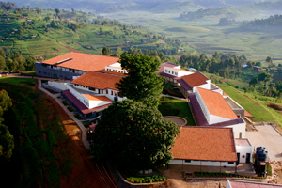
NGO Innovation: Focus on Health Equity and the Dignity of the Poor and the Underserved
The Creation of Partners in Health Canada
After meeting Drs. Paul Farmer and Jim Kim, Alain Martin mobilized a Harvard alums’ team to create “Partners in Health Canada” and harness Canadian solidarity and generosity. He applied Harvard® tools to probe the mission with PIH-Boston, craft strategy, mobilize allies, incorporate PIH Canada, establish an interim office at Saint Paul University, organize funding events, and build a fuel truck for PIH clinics in inaccessible Haiti’s hills. Below is Professor Farmer’s feedback about the initiative.
“Mr. Martin tirelessly invests his energy to leverage his successes and networks into solutions that have a direct, positive impact on the poor…
Mr. Martin’s management background and extensive experience in advising global leaders, alongside his motivation to eradicate poverty and its ill effects, qualify him to make a uniquely valuable contribution to addressing inequity on a societal level. With demonstrated skills in entrepreneurship, negotiation, and issue analysis, he is precisely the sort of thoughtful, versatile leader we need to advocate on behalf of the poor and underserved."
Prof. Paul E. Farmer, MD, PhD
Chair, Global Health & Social Medicine, Harvard Medical School
Chief, Global Health Equity, Brigham & Women’s Hospital
Co-founder, Partners In Health (pih.org)
IMPORTANT: When your time permits, please read the brief message:
Inspiring Stories about Dr. Paul Farmer for Aspiring Counterparts at www.eharvard.org/Paul-Farmer.pdf.
TM
Photo by Cjmadson, Wikimedia Commons (cropped)
Harvard University Global System™
The Professional Development Institute® PDI Inc.
www.eharvard.org
Butaro Hospital, PIH modern-teaching hospital
the largest public facility in Rwanda.
.

Slide 6
Pro-Bono First-Hand User Testimonial by
Dr. Rob Stephens, PhD Nanotechnology
Past Director, Applied Research & Technology
Teck (Canada’s Largest Diversified-Resource Firm)
Past Chair, The Extraction and Processing Division
The Minerals, Metals and Materials Society (TMS)
12-Year User of Harvard University Global System™ in
Co-Elevating Leadership
Collaborative Innovation, Principled Negotiation,
Risk & Project Management for Exemplary Teams
™
Harvard University Global System™
North America: Toll Free: 1-800-HARVARD or +1 819 772-7777
Europe : +33 7 68 47 23 11 ● www.eharvard.org
.

Slide 7
Subsequently, at SAAQ: unprecedented success in inversing the casualty curves saving thousands of lives, reducing severe injuries and eliminating nearly half a billion dollar deficit, despite a 12%t increase in traffic, as described in the next slide (same video). All in five years.
The next three slides illustrate the experience of Mr. John Harbour,
who was now mentioned
by Dr. Rob Stephens.
TM
Harvard University Global System™
The Professional Development Institute® PDI Inc.
www.eharvard.org ● © Alain Paul Martin, 2023. All rights reserved

Slide 8
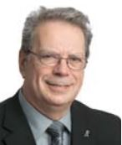
Harvard University Global System™ at Desjardins
Testimonial by Mr. John Harbour
12-Year Harvard® Tools’ User in Three Presidential Positions
With $100 million in casualty-insurance sales, Desjardins was lagging Zurich, ING, AXA... Focusing on client benefits, Desjardins’ team and Alain Martin probed the independent experts’ work of Profs. Olivier Giscard D’Estaing (INSEAD, Generaly, IBM), Takaaki Wakasugi (Tokyo & Michigan), Mark Thompson and Richard Zeckhauser (Harvard Kennedy School).
They also scrutinized Desjardins’ competitors’ value chains and competitive advantages, before exploring innovative options, from regulations and design to client services.
Desjardins had to change its strategic policies, alliances, structure and processes to leapfrog competitors, incl. the largest Canadian banks. It partnered with the Crédit Mutuel, crafted a novel digital and client-friendly strategy, featuring 15% discount in rates. Implementation was gradual and psychographics-based to manage resistance to change, by forming a clients’ critical mass, as a condition for a ripple effect across the 1,400 branches. Retailing insurance in-house led to a generic growth in viable cross-selling opportunities for the conglomerate’s 5-million members; thus, a sustainable leverage to outpace the competition for years.
John Harbour
© SAAQ with permission
of Mr. Harbour
Impact: ● Competitors lowered their insurance rates, yielding unprecedented savings to millions of customers.
● Within 5 years, profit multiplied by a factor of ten. Sales grew to multi-billion dollars in 10 years.
● Desjardins repatriated strategic expertise by funding advanced finance, including actuarial research.
TM
Harvard University Global System™
North America: Toll Free: 1-800-HARVARD or +1 819 772-7777
Europe : +33 7 68 47 23 11 ● www.eharvard.org

Slide 9
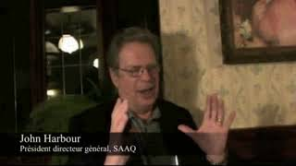
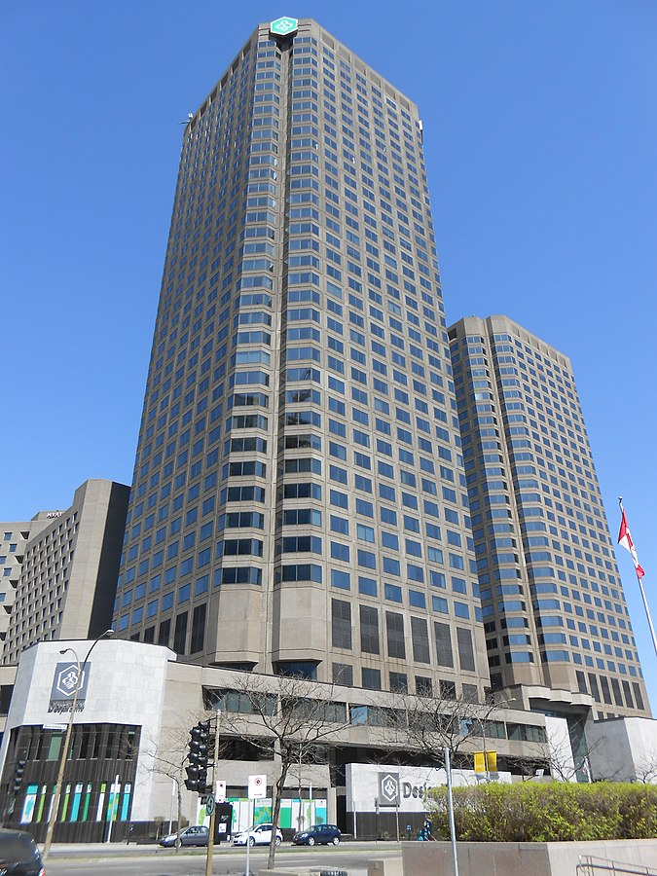
Testimonial by DESJARDINS: North-America Largest Community Bank
Rated by Bloomberg Among the World’s Strongest Banks for over 10 Years
7-Year Teamwork with Innovative Strategies Stimulating Higher Competition
“I have used [this framework] successfully for years to orchestrate the turnaround of North America's fastest growing casualty-insurance firm [quadrupling sales with tenfold raise in profit in five years], and ultimately, to craft the vision and strategic direction of Desjardins, a $75 billion financial institution.”
John Harbour, President (Ret’d)
DESJARDINS (Staff: 48000)
Mr. Harbour praised Alain Martin for bringing impartial and eminent experts. In this video, he also describes how Mr. Martin’s innovative ideas, strategic expertise and Harvard® framework played an important role in Desjardins’ turnaround from a trailing performer to the undisputed general-insurance leader in and beyond its territory. Promoted Desjardins’ president, Mr. Harbour applied Martin’s Harvard® framework across the $75-billion financial institution, as confirmed above.
TM
Harvard University Global System™
North America: Toll Free: 1-800-HARVARD or +1 819 772-7777
Europe : +33 7 68 47 23 11 ● www.eharvard.org
Complexe Desjardins
JeanGagnon
Wikimedia Commons,

Slide 10
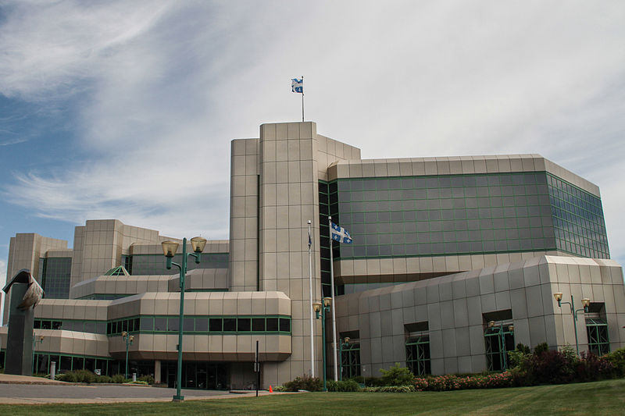
Government Illustration in Life Saving
Harvard University Global System™ Tools
Helped Saving Thousands of Lives in Five Years
−35% Deaths ● −43% Severe Bodily Injuries ● Despite +15% Highway Traffic
Turning $486 Million hemorrhaging deficit into a surplus of $20 million; all in 5 years.
For Mr. Harbour, corporate achievements were just a milestone in his leadership journey. The next challenge was to tackle casualties upstream in the highway-safety ecosystem, beyond the insurance-industry’s control.
Nominated by Premier Jean Charest as CEO of the SAAQ, a government agency saddled with $486 million deficit and fast growing casualties, Mr. Harbour brought, for the third time, Alain Martin to coach the SAAQ team, which in five years, achieved the above remarkable goals.
John Harbour, SAAQ President (ret’d). Video in French: ww.eharvard.org
In the above video, Mr. Harbour praised Alain Martin for helping the SAAQ team reverse the growing trend in casualties and save thousands lives in five years.
SAAQ Headquarters,
by Elias Touil, Wikimedia Commons,
TM
Harvard University Global System™
The Professional Development Institute® PDI Inc.
www.eharvard.org ● © Alain Paul Martin, 2023. All rights reserved

Slide 11
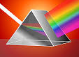
The Harvard University System™ includes unique practical
instruments mentioned by Dr. Rob Stephens:
The next two slides
reveal a fraction of the Stakeholders’ Engagement Prism™.
From the 3rd slide, further insights can be gleaned
from combining the Power-Dynamics’ Template
with factional-perceptions’ intelligence,
prior to creating a sustainable strategy.
commons.wikimedia.org/wiki/
File:Breking-van-het-licht.jpg
TM
Harvard University Global System™
The Professional Development Institute® PDI Inc.
www.eharvard.org ● © Alain Paul Martin, 2023. All rights reserved

Slide 12
Alain Paul Martin’s Stakeholder-Engagement Prism™
Deep Diving into the Factional Intelligence (Perceptions, Biases & Motivations)
Stakeholders’ Universe
Vested Interest: Motivation and/or Perception of Our Goals
F1: Family F1
Our goals are perceived as Vital to theirs.
F2: Friends F2
Our goals are perceived as Important NOT vital to theirs.
F3: Fellow-travelers F3
Our goals are perceived merely as Nice to Have for theirs.
F4: Fence-sitters F4
Neutral by choice, ignorance, necessity (judges, journalists) or fear
F5: Foes F5
Often rational adversaries who perceive our goals in a zero-sum game.
Born or acquired
Acquired foes often tough.
Potential ad-hoc allies or residual foes?
F6: Fumblers F6
Dangerous by accident.
Unpredictable or volatile perceptions?
Issues: Listening, discretion, loyalty, goal clarity? Used by F5s
F7: Fiascos, Fanatics F7
Systematic obstruction regardless of
consequences including self-destruction. Often move Stealthily.
Dangerous by design.
Impending deal disruptors
Avoid profiling people: The prisms are issue dependent, NOT a personality trait.
Validate your team grouping to avoid biases (attribution, anchoring, framing, prejudice…)
Prior to 2022, HUGS Stakeholders’ universe comprised the above seven factions (F1 to F7).
In 2022, the hybrids (Fx/y) and three factions were added: Followers (F0) and unknowns (F8-F9).
™
Harvard University Global System™
North America: Toll Free: 1-800-HARVARD or +1 819 772-7777
Europe : +33 7 68 47 23 11 ● rsvp@eharvard.org
© Alain Paul Martin, 2023. All rights reserved.
We train trainers and license users.

Slide 13

Alain Paul Martin’s Stakeholder-Engagement Prism™
Register at www.eharvard.org to Martin’s free webinar: Stakeholders’ Engagement Prism™.
Stakeholders’ Universe
Vested Interest: Motivation and/or Perception of Our Goals
F0: Followers F0
Ad-hoc or unequivocal loyalty, reciprocity, fear or strategic vote
F1: Family F1
Our goals are perceived Vital to theirs.
F2: Friends F2
Our goals are perceived Important NOT vital to theirs.
F3: Fellow-travelers F3
Our goals are perceived merely as Nice to Have for theirs.
F4: Fence-sitters F4
Neutral by free choice, ignorance, necessity (judges, journalists) or fear
F5: Foes F5
Often rational adversaries who perceive our goals in a zero-sum game.
Born or Acquired
Acquired foes often tough.
Potential ad-hoc allies or residual foes?
F6: Fumblers F6
Dangerous by accident.
Unpredictable or volatile perceptions?
Issues: Listening, discretion, loyalty, goal clarity? Used by F5s
F7: Fiascos, Fanatics F7
Systematic obstruction regardless of
consequences including self-destruction. Often move Stealthily.
Dangerous by design.
Impending deal disruptors
F8: Known-unknowns F8
Known parties with unknown (or Fuzzy) vested interests
F9: Unknown Unkowns F9
Unknown parties & interests, even if ubiquitous (dark horses, the voiceless)
F$x/y$: Hybrids
e.g. Frenemies (F⅖)
see our goals as important (F2); but they see us as F5;
Family Feuds ^{(F}$1/{5,6 or 7}$⁾
see goals as vital (F1); but they resent or mistrust us (F5+).
™
Harvard University Global System™
North America: Toll Free: 1-800-HARVARD or +1 819 772-7777
Europe : +33 7 68 47 23 11 ● rsvp@eharvard.org
© Alain Paul Martin, 2023. All rights reserved.
We train trainers and license users.

Slide 14
Alain Paul Martin’s Stakeholder Dynamics™ – Excerpt 3/9
From the Factional-Intelligence Tools to the Power-Dynamics’ Template and Strategy Design
The following teamwork is best done with ongoing access to contextual expertise, intelligence sources and effective listening to stakeholders with empathy, a dose of humility and a strategic mindset.
1. Unveil & characterize the unknowns. Attend our free webinar: The Stakeholders’ Engagement Prism™.
2. Team-up to regularly validate the stakeholders’ perceptions, which we can only ignore, at our goals’ peril. Perceptions (of our honesty, commitment, mission, goals, deliverables…) change over time, within and across issues. They fluctuate with stakeholder’s interests, skills, biases, surprise events, fears, beliefs (overconfidence, delusions), precedents (power abuse, disinformation, corruption…) and our own track record, integrity, fair play and biases. All perceptions are prone to blind spots, especially F8-F9.
3. We must probe which stakeholders, and other players outside the F-Scale echosystem but within reach, have the power of influence and the skills to play even a limited role as facilitators, connectors, conductors (architects of change), backers, negotiators, mediators or blockers, even if uninterested now.
Armed with such intelligence and HUGS tools (Innovation Template), we can seek insightful questions, creative options (expand the pie) for the best strategy to address mutual interests, misperceptions, timing and risks, incl. residual risks. Complacency and surprise events may pull the players down on the F-scale. Consider ascending moves (e.g. from F4-F5 to F3-F2) by selective engagement, building trust with a demonstrated commitment to partnership… Such antigravity moves can turn todays’ foes into either ad-hoc or lasting allies.
™
Register at www.eharvard.org to Martin’s free webinar: The Stakeholders’ Engagement Prism™.
Harvard University Global System™
North America: Toll Free: 1-800-HARVARD or +1 819 772-7777
Europe : +33 7 68 47 23 11 ● rsvp@eharvard.org
© Alain Paul Martin, 2023. All rights reserved.
We train trainers and license users.

Slide 15
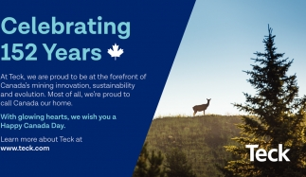
2014 Users’ Testimonial
2. THE INNOVATION FUNNEL:
AN ILLUSTRATION of “INVENTION”,
THE FIRST VARIABLE of THE FUNNEL
“Alain Paul Martin has a long and valued association
with Teck Metals Ltd. We believe that Alain’s teachings
go far beyond the typical project management focus on
scope, schedule, cost, and, sometimes, quality.
Alain delves into topics that project managers working with complex issues or program managers dealing with multiple complex and often inter-related projects need to know about, and must become skilled at, to be successful. These teachings are supported by tools that we and our teams use on a regular basis to move ideas and concepts into well-defined projects that can be managed with conventional project-management tools."
Rob Stephens, PhD (Nanotechnology)
Director, Applied Research & Technology
TECK RESOURCES
John Higginson
Manager, Technical Services (Retired)
TECK RESOURCES
TM
Harvard University Global System™
The Professional Development Institute® PDI Inc.
www.eharvard.org ● © Alain Paul Martin, 2023. All rights reserved

Slide 16
2023 User’s Testimonial
2. THE INNOVATION FUNNEL:
AN ILLUSTRATION of “INVENTION”,
THE FIRST VARIABLE of THE FUNNEL
“I continue to use the Harvard University Global System™
in innovation and project management. With it, teams gain
a strategic head start, by starting earlier and going deeper, well beyond
its counterparts, such as IDEO, Stage-Gate, TRIZ and other innovation methods and change-management processes (ADKAR), which can effectively feed into it.”
Rob Stephens, PhD (Nanotechnology), Entrepreneur
Innovation & Strategic Transformation, Mining & Advanced-Materials Industries
Former Director, Applied Research & Technology, Teck Resources
TM
Harvard University Global System™
The Professional Development Institute® PDI Inc.
www.eharvard.org ● © Alain Paul Martin, 2023. All rights reserved

Slide 17

™
Thank you Dr. Rob Stephens
for this pro-bono public-service feedback, which provides invaluable insights
into our synergistic journey, on both sides of the Atlantic Ocean, to harness
the power of collaborative innovation and leadership in sustainable mining,
energy conservation and environmental remediation, three areas
where you continue to push the boundaries of technology
and policy, now beyond the large conglomerate realm.
Alain Paul Martin
The Professional Development Institute PDI Inc.

Slide 18
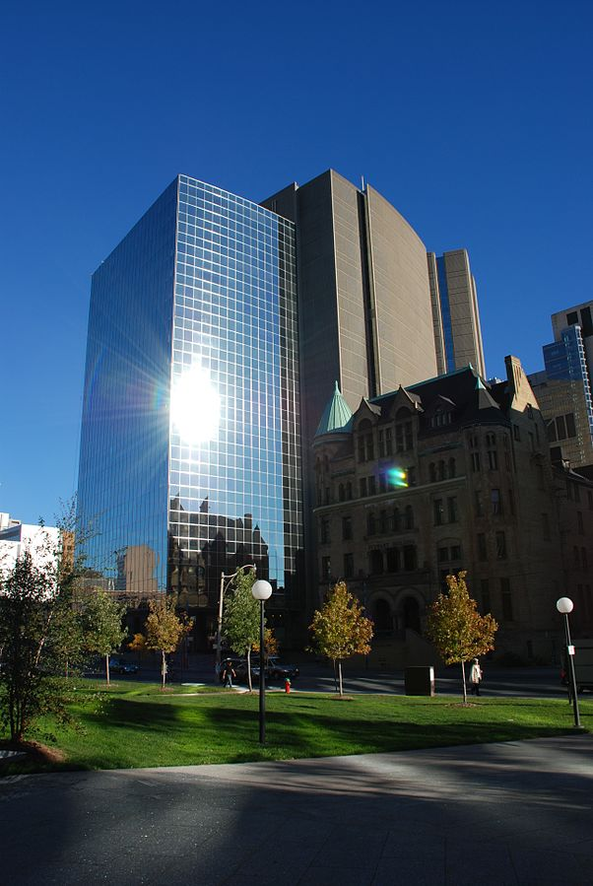
Testimonial of North-America’s Leading Nuclear-Risk Manager
Ontario Power Generation
“Alain [Paul Martin] delivered, over a 4-year period, ‘Advanced Project and Risk-Management’ workshops to our nuclear project managers and executives at Ontario Power Generation [OPG]…
These sessions covered the complete project-management cycle from project and risk incubation to stakeholder analysis and strategy formulation to operational planning including estimating, resource allocation, budgeting, earned-value planning and progress control. Including myself, the sessions were taken by approximately 200 OPG Project Managers, Sr. Engineers and Executives. Feedback from all sessions were excellent. Course materials and instruction exceeded all of the requirements established by OPG."
Mark Arnone
Vice-President
Nuclear Refurbishment
ONTARIO POWER GENERATION
Ontario Power Generation
(MarcusObal, Wikimedia Commons)
Note: Alain Martin delivered seminars for the energy sector, in Canada the U.S. and abroad, both upstream in R&D and production of nuclear reactors, hydro and wind power (E.ON) and downstream in power generation.
TM
Harvard University Global System™
The Professional Development Institute®
www.eharvard.org

Slide 19
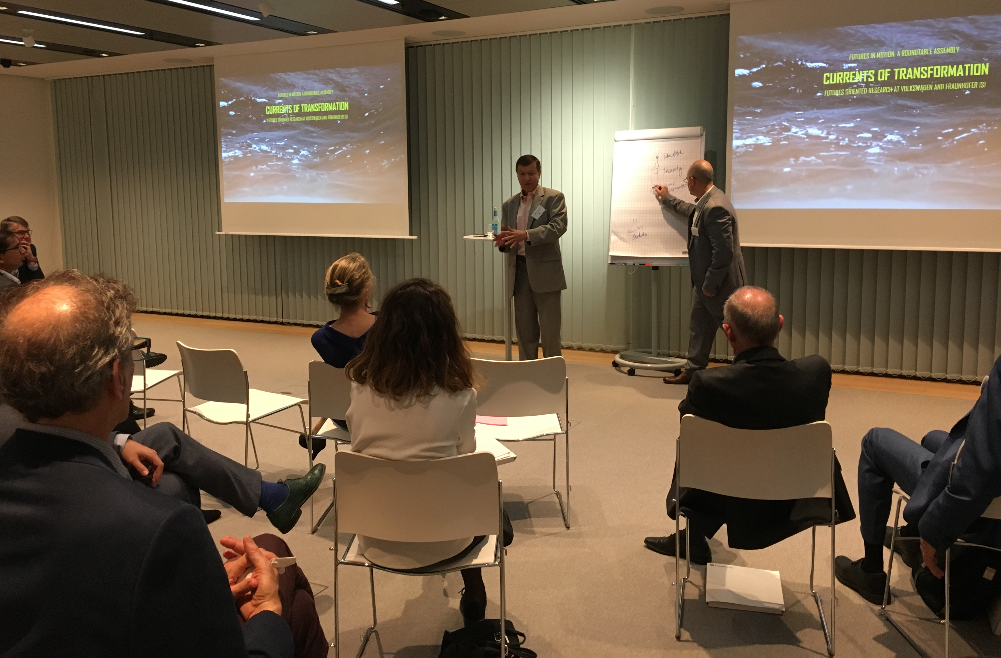
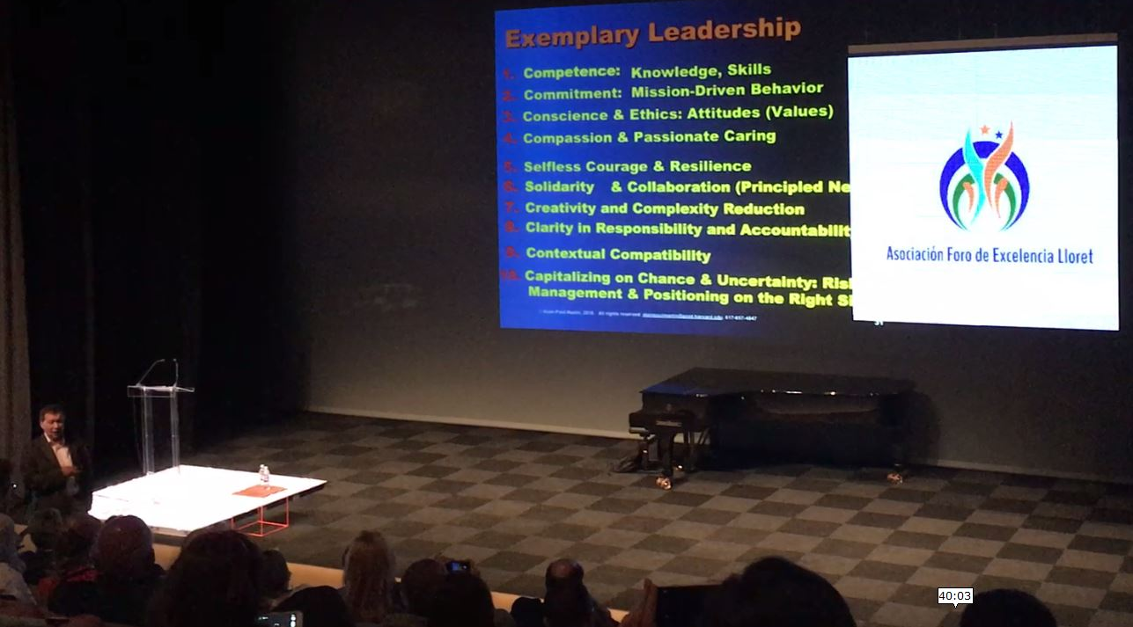
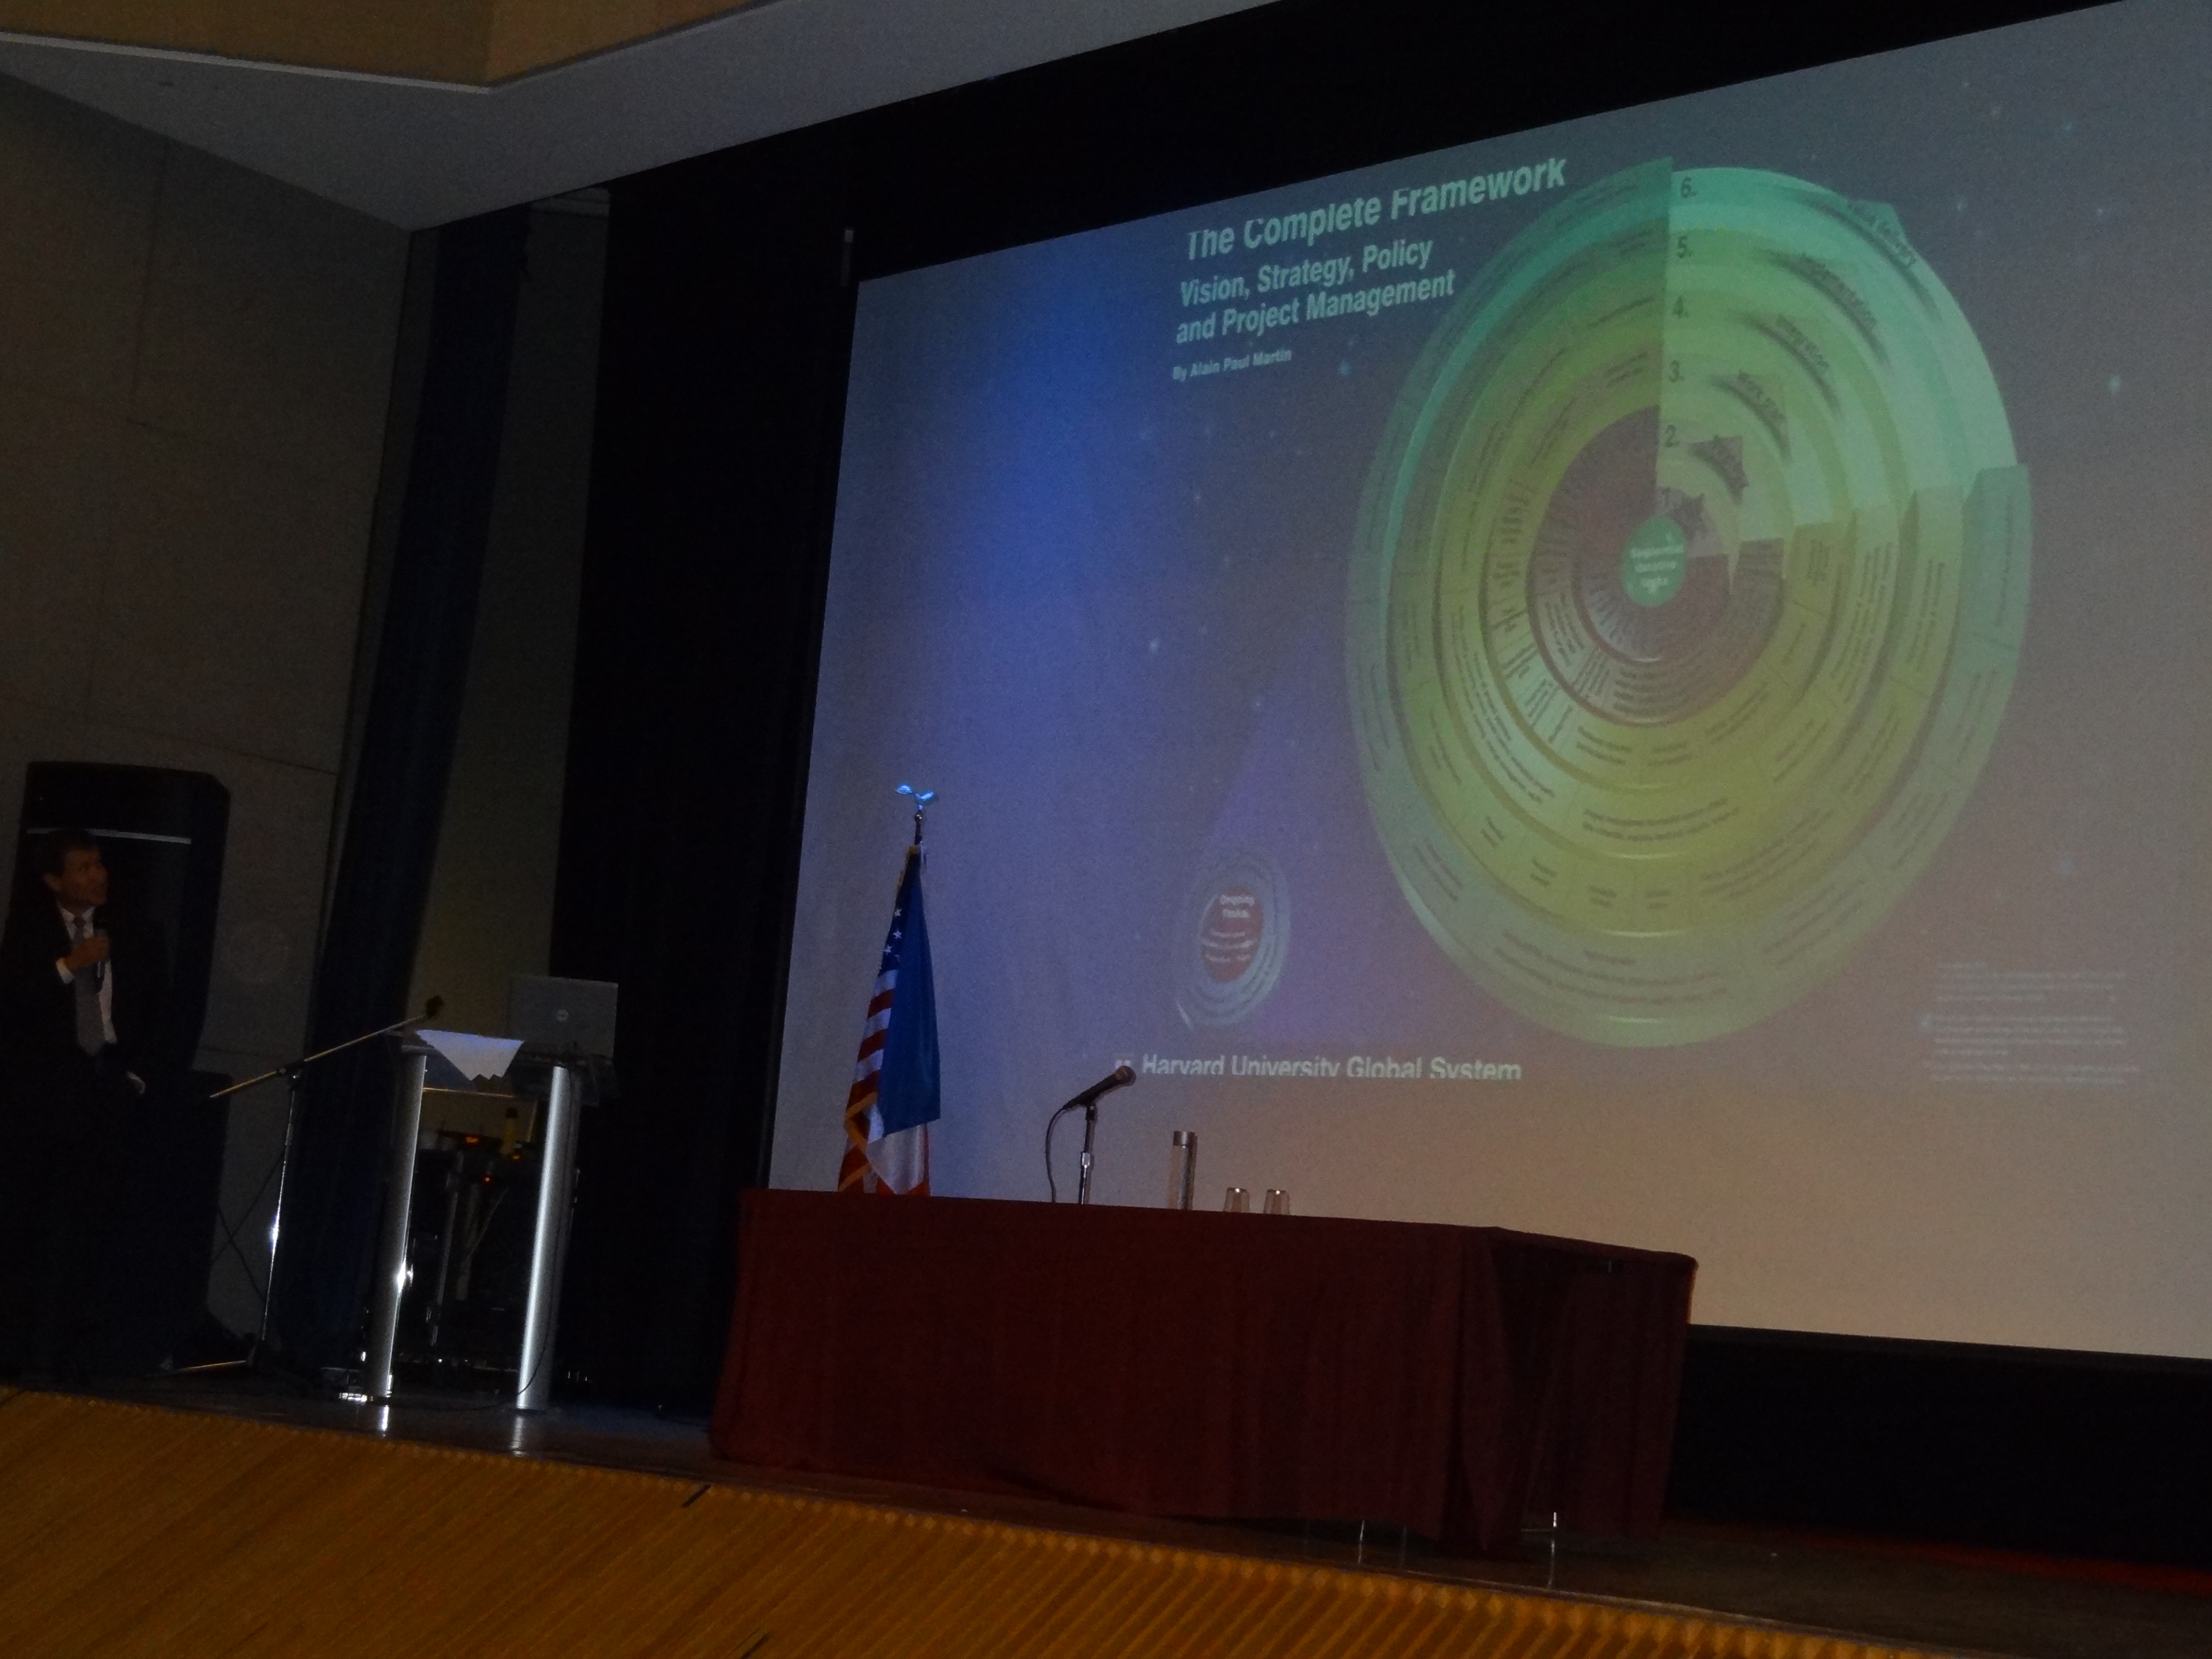
Engaging Global Innovators and Aspiring Leaders
“I was privileged to work with Alain Martin at Harvard University, attend his lectures and provide technical support for his research on complexity reduction. Alain cares deeply about the students he mentors, Harvard staff and his Advanced Leadership colleagues. He is passionate about social justice. His compassion for the less privileged is genuine. Candid to share his mistakes, he welcomes critical scrutiny of his work, listens, validates and acts on suggestions. A model leader and educator with a touch of humility and captivating public speaker!”
Cochise Pearson, M.Ed.
President Ivy Scholars Success
Cambridge, MA
Alain Paul Martin was among the leading experts invited to Berlin, by VW’s research director to explore the future of mobility.
Alain Martin leading a session on Innovation Leadership with Nobel laureates, corporate leaders and students at the Excellence Forum
in Spain
“Alain Martin understands the fleeting-coalitions’ dynamics and the subtleties of context, wording and tone in multilateral negotiations. He helped community banks such as Desjardins prepare for NAFTA; played a role in forging strategic-partnerships and advancing bilateral cooperation between countries. His relentless focus on gender equity and mentoring aspiring leaders is commendable.”
Danièle Testelin
Senior Advisor (Retired)
International Development
Global Affairs Canada
Sharing research and Harvard® tools on managing the stakeholders’ dynamics and surprise events, with participants from Chicago, Harvard and Penn Alumni Clubs and the French-American Chamber of Commerce, at the French Embassy in Washington
TM
Harvard University Global System™
The Professional Development Institute® PDI Inc.
www.eharvard.org

Slide 20

Deep Diving into Workers’ Self Actualization and Dignity
National Trade Union’s President
“[We] are a Canadian trade union with a progressive approach to labour relations. We are strong advocates of Alternate Dispute Resolution and Interest-Based Negotiation.
[After] participating in a professional-development seminar applying Harvard University Global System™’s tools, our executive assistant recommended the services of Alain Martin.
For nearly two years, Mr. Martin has acted as a strategic advisor and a seminar leader, first working with our executive committee, and subsequently with our national board representing 28 branches across the country.
The focus of our professional work has been on exemplary leadership, strategy, governance, strategic alliances, interest-based negotiation, conflict resolution and risk mitigation. Although these topics were effectively addressed in the past, Alain Martin was the first to bring to light the intricate dynamics between them with the support of Harvard University Global System™’s extensive library of templates and roadmaps.
Armed with better skills and cutting-edge practical instruments such as the Negotiation Mandate, the Responsibility Chart and Harvard® Creativity Templates, we can, with less guesswork, better simulate and validate each negotiation party’s scope and value chain, clarify our respective roles, define the conditions beyond each party’s control and explore in-depth a wide range of risk and conflict-resolution scenarios.
We at APOC are fortunate to work with Alain Paul Martin and delighted to recommend his exemplary leadership and negotiation-excellence seminars, as well as his coaching and consulting services.”
Guy Dubois
National President
THE ASSOCIATION OF POSTAL OFFICIALS OF CANADA (APOC)
TM
Harvard University Global System™
The Professional Development Institute® PDI Inc.
www.eharvard.org

Slide 21
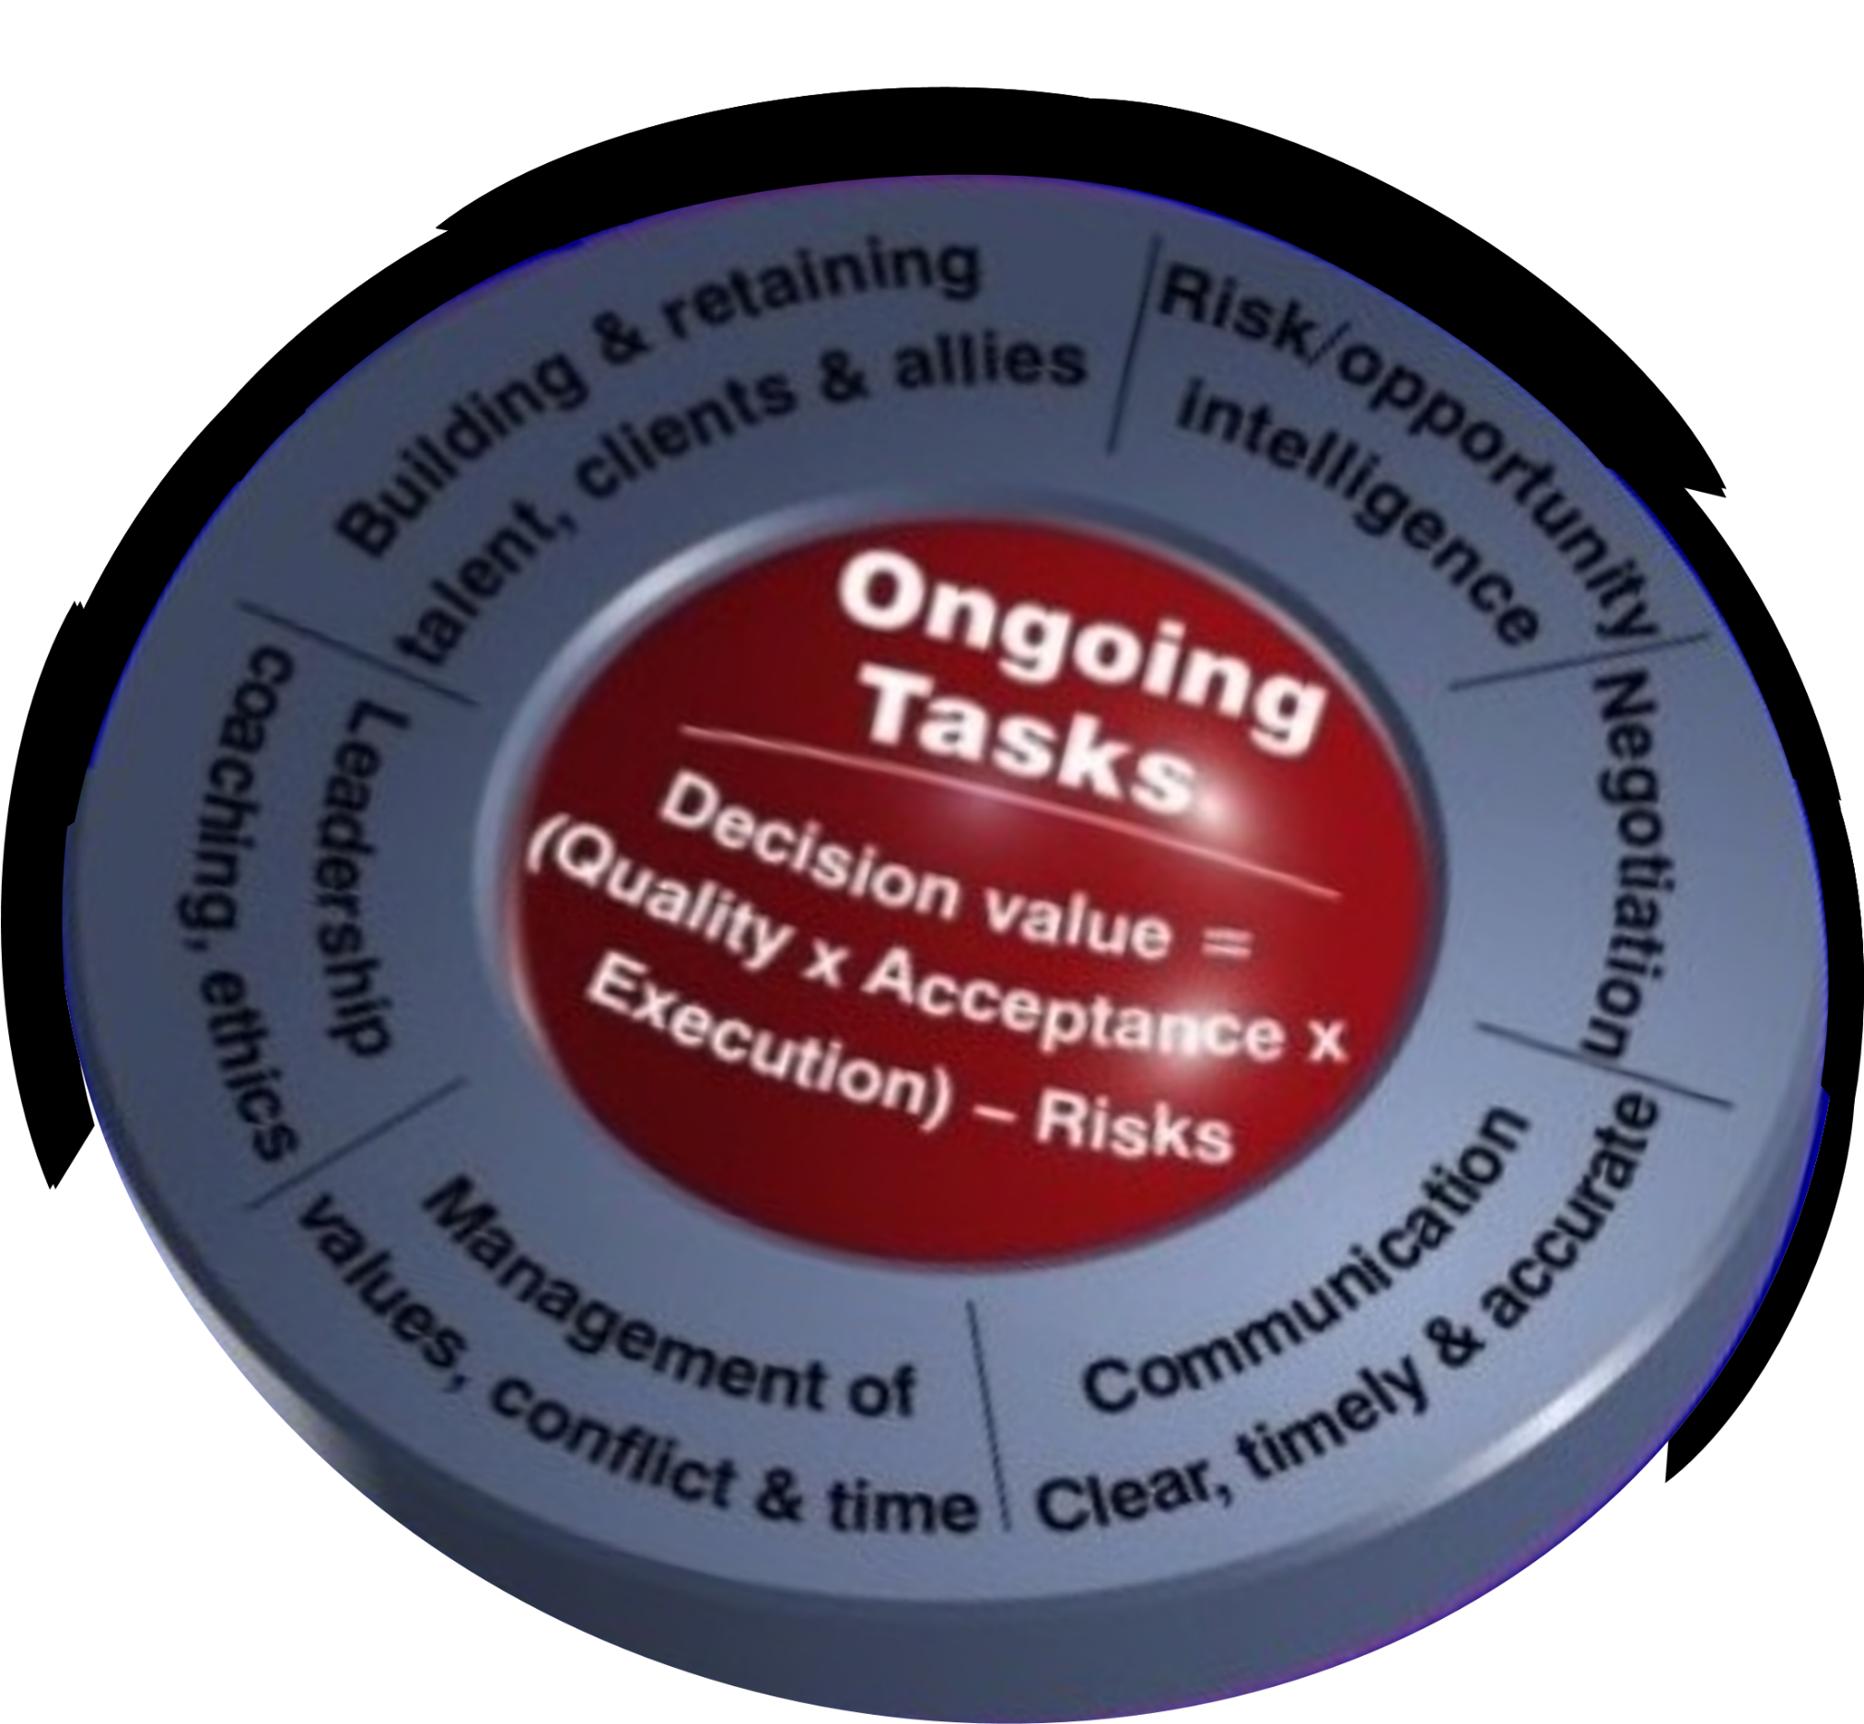

Ongoing Value-Integration Tasks
Principled-Negotiation Roadmap
“I enjoyed acquiring new ideas in strategy formulation, negotiation skills and
leadership. The exercises and simulations gave a good hands-on practice.”
Savi Sachdev
Director General, Space Systems
Canadian Space Agency
“I have worked with Alain Martin on many occasions to improve business strategy and execution; and coach my management team. I also attended his leadership
and negotiation-skills programs. A remarkable strategist with the typical rigor
and discipline of a professional engineer, he has helped me reframe and
solidify our strategy to deliver key business outcomes.
Great coach, I owe him a lot.”
Gilles Morin, B.Sc., MBA
Vice-President, Export Development Canada
Videos: https://youtu.be/-J78rfmVtOI
https://youtu.be/iejtEl4fojw
TM
Harvard University Global System™
The Professional Development Institute® PDI Inc.
www.eharvard.org ● © Alain Paul Martin, 2023. All rights reserved

Slide 22
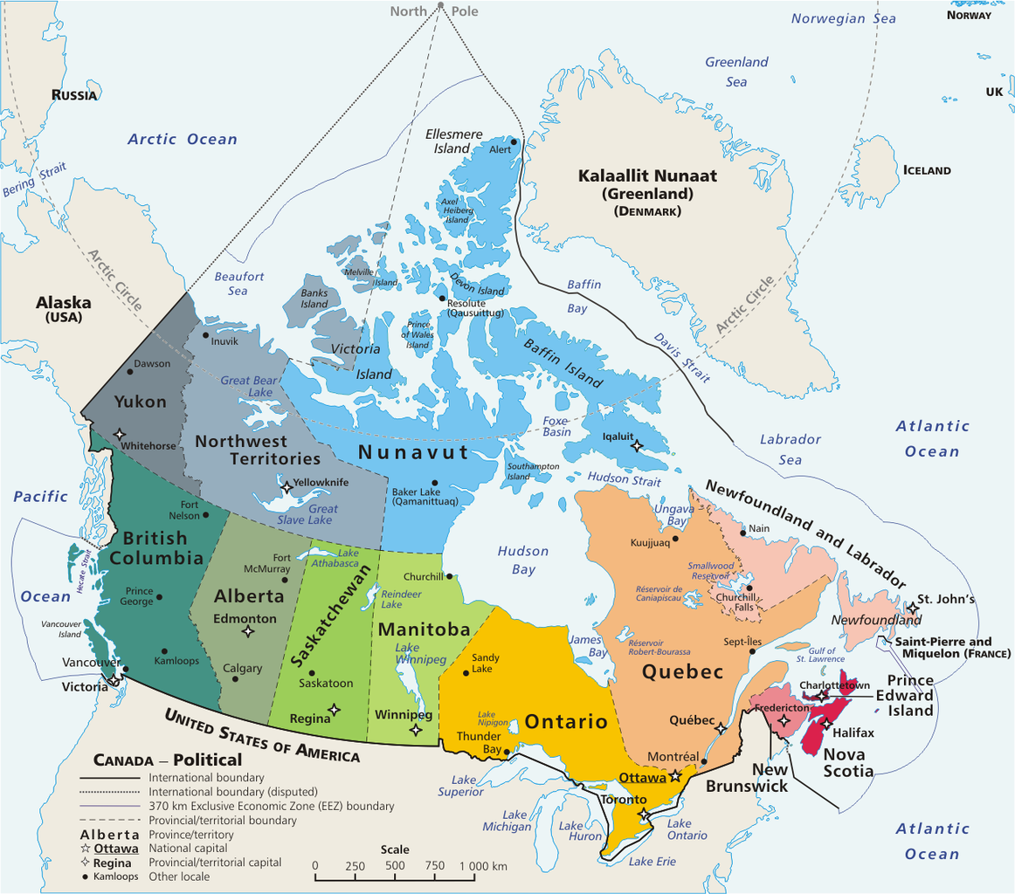
Serving The First Nations and Northern Institutions
Empowering Professionals to Advance Equity, Economic Empowerment,
Sustainable Development and Environmental Remediation
As illustrated in Ms. Carla Conkin’s upcoming testimonial, our work has a lasting positive impact on the environment and Indigenous Communities.
We listen and learn about the vision, goals and underlying issues facing communities from the West Coast, the Northwest Territories (NWT) and Nunavut (up to Alert) to Northern Québec and around the circumpolar Arctic.
Our consulting and skills-development work contributes to leadership, economic empowerment (technological literacy, digital transformation, startups and scaling), sustainable development, land-claim negotiations and natural-resource management, from exploration to environmental remediation.
E. Pluribus Anthony from Atlas of Canada (commons.
wikimedia.org /wiki/File:Map_Canada_political-geo.png)
TM
Harvard University Global System™
The Professional Development Institute® PDI Inc.
www.eharvard.org

Slide 23
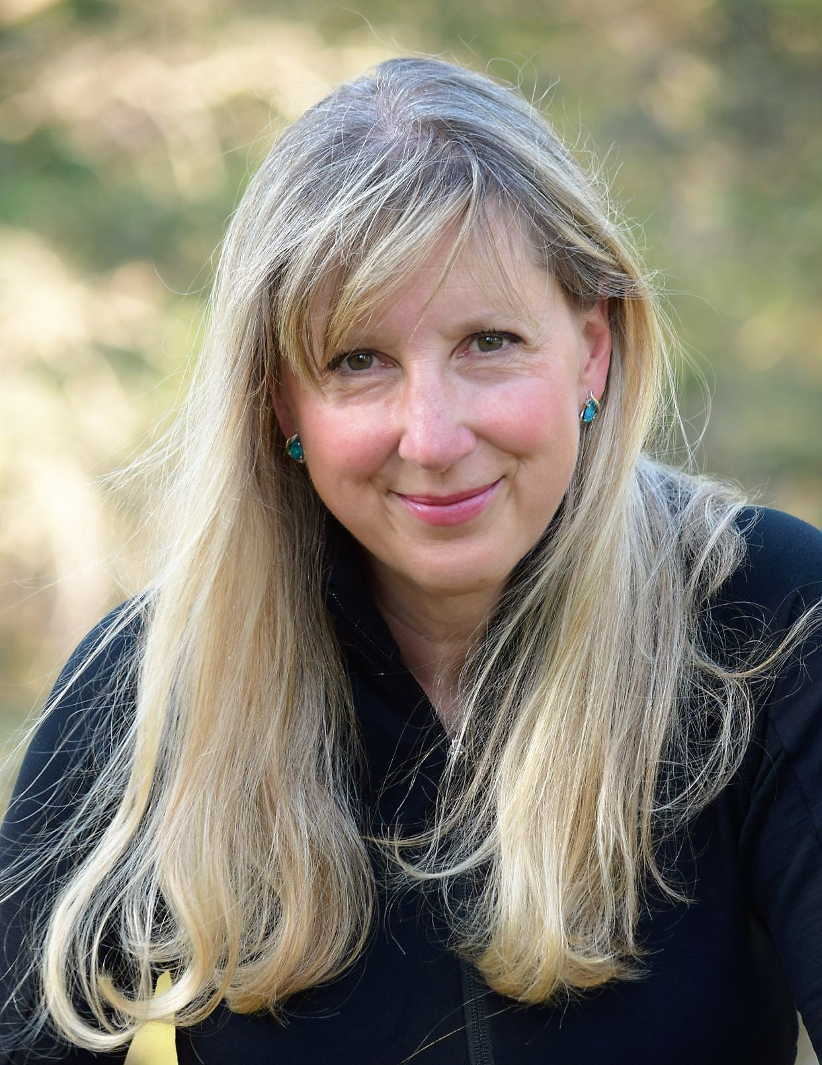
Pro-Bono First-Hand User Testimonial by
Ms. Carla R. Conkin, LL.B.
Regulatory Environmental Lawyer, Arbitrator, Consultant Large Mines’ Liabilities Assessment and Remediation
Commissioner, Impact Assessment Agency of Canada
Acting Chair, Inuvialuit Arbitration Board
Former Regulator and Policy Maker
13-Year User of Harvard University Global System™ in
Complex Risk Management
Environmental Impact & Liabilities Assessment,
Principled Negotiation and Arbitration
™
Harvard University Global System™
North America: Toll Free: 1-800-HARVARD or +1 819 772-7777
Europe : +33 7 68 47 23 11 ● www.eharvard.org

Slide 24

Harvard University Global System™ (HUGS)
Risk Management
In risk management, there is no tolerance for generalities.
Harvard® roadmaps and templates must be adapted to the contexts
and ecosystems of clients and users, project requirements,
including the extended team’s and partners’ capabilities.
TM
Harvard University Global System™
The Professional Development Institute® PDI Inc.
www.eharvard.org ● © Alain Paul Martin, 2023. All rights reserved

Slide 25
™
Thank you Ms. Carla Conkin
This pro-bono public-service feedback provides invaluable insights
into your virtuous environmental and health-protection mission,
in the Northwest Territories and now across Canada.
Your work is a tall order with a direct impact on diversity
and the quality of wild and human lives.
Video in French
www.eharvard.org
Professional leaders like you are
our best hope for a sustainable future.
I feel privileged to be an ad hoc member of your team.
Alain Paul Martin
The Professional Development Institute PDI Inc.

Slide 26
The Harvard® Roadmap for Exemplary Innovation
mentioned by Dr. Rob Stephens is now integrated with our:
Framework for Principled Innovation
and Co-Elevating Team Leadership
Please see further insights on this Framework
following the users’ feedback.
™
Harvard University Global System™
North America: Toll Free: 1-800-HARVARD or +1 819 772-7777
Europe : +33 7 68 47 23 11 ● rsvp@eharvard.org

Slide 27
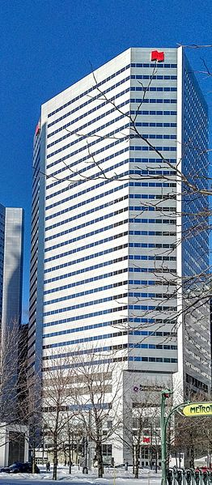
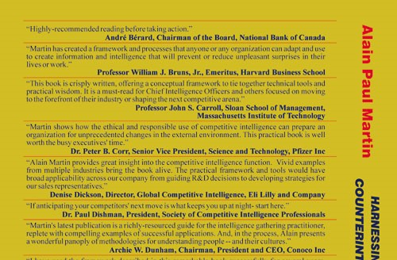
User Testimonial, Board Chairman, National Bank of Canada
The Bank Has Been a 25-Year Distinguished User of Harvard® Products
The Bank is among world’s top ten strongest banks (Bloomberg) and best performers (balanced revenue portfolio, capital adequacy, profitability, asset quality, rigorous risk management and sustainable growth).
“In today's turbulent business environment, decision-makers in global companies, particularly financial institutions, need a clear vision, effective strategies and state-of-the-art execution. In [the book Harnessing the Power of Intelligence, Counterintelligence and Surprise Events], Alain Martin provides thought-provoking analyses, a practical framework and concrete examples of how to develop the business intelligence required to support these three major challenges. Highly recommended reading before taking action.”
André Bérard, Chairman of the Board, National Bank of Canada
Our partnership with the Bank, as a distinguished client and user
of Harvard® products, has been long lasting (25 years till COVID-19).
For years, Mr. Martin advised the Sr. V.P. Audit and Human Resources, on governance, exemplary leadership and strategy, and in her three previous positions, both as deputy minister and at the Executive Board.
Harnessing the Power of Intelligence,
Counterintelligence & Surprise Events
National-Bank Tower
PierreCommons5018
Wikimedia,
TM

Slide 28
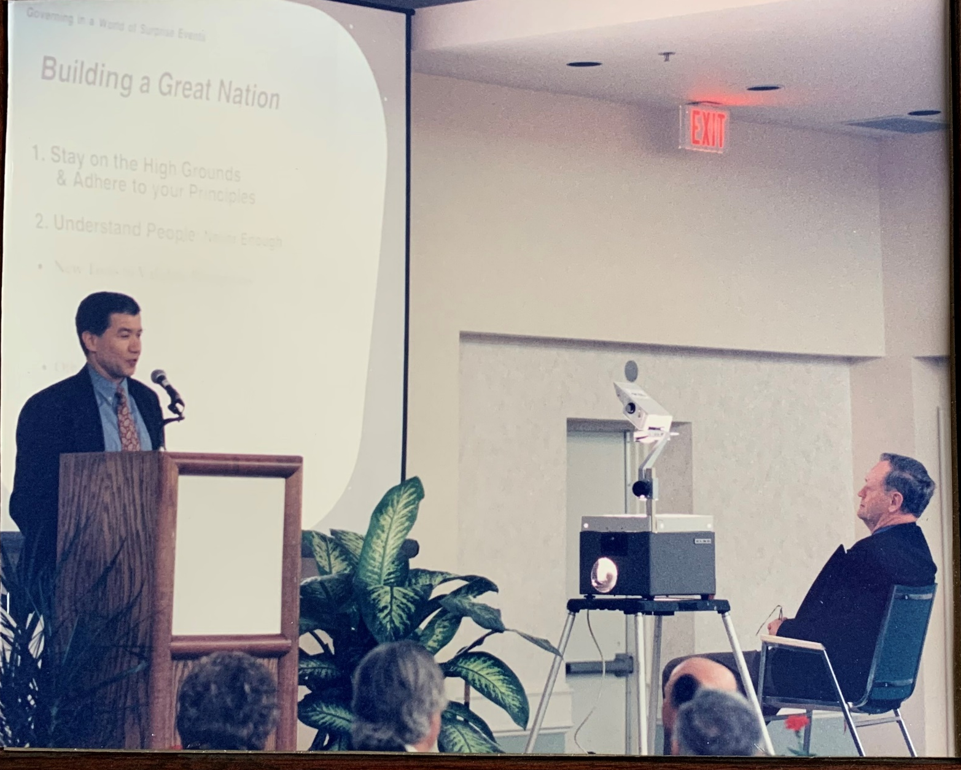
Following a meeting at Harvard University with Canada’s Privy Council’s Minister Marcel Massé, Alain Martin agreed to serve as a non-partisan pro-bono member of the Prime Minister’s Committee on Government Reform; and later the Public Service Committee. He also led pro-bono sessions on Building a Great Nation, unrelated to the above roles.
A lawyer by profession, Mr. Jean Chrétien was elected to parliament in 1963, at the age of 29. From 1967 to 1984, he served as minister of important cabinet portfolios (Energy, Mines & Resources, Finance, Foreign Affairs, Indigenous Affairs, Industry, Trade & Commerce, Justice and the Treasury Board), as well as opposition leader for three years. As a minister of Justice, he played a crucial and historic role in repatriating and modernizing the Canadian Constitution, including the creation of the Charter of Rights and Freedoms.
Known as a pragmatic, caring and experienced public-service leader, Prime Minister Jean Chrétien (1993-2003) won three elections with a parliamentary majority. His team restored fiscal discipline while pursuing responsible progressive policies; turning alarming deficits into modest surpluses.
Harnessing the Power of Caring, sm for the Federalism and Global Alliances over I

Slide 29
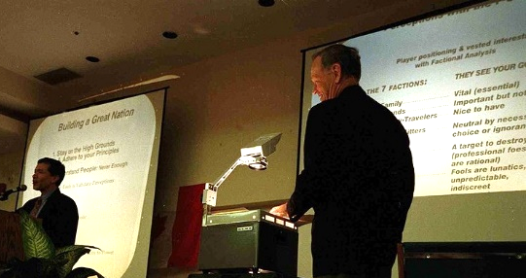
Harvard University Global System™ (HUGS)
The Journey Toward a Socioeconomically Vibrant Nation
“Building an inclusive, just, diverse, innovative and economically vibrant nation is more challenging than ever, even in countries where democracy flourishes.
No panacea exists; but, the precursor jurisdictions with a culture of power sharing, consensus building, collaboration, community-wide participation, caring and responsible team leadership tend to lead the rest.
These leaders excel when they cultivate and retain co‑elevating teams, characterized by competence, lifelong learning, ethics and solid commitment to mission. Equipped with flexible decision-support systems, these teams spare no effort to deliver quality, reduce the carbon footprint, lift biodiversity, and forge strong stakeholder alliances, within and beyond their organization and country.”
Cropped Photo. © Jean-Marc Carisse. www.carissephoto.com
Assisted by Prime Minister Jean Chrétien during an address on “Building
a Great Nation” to Liberal members of Parliament, Alain Paul Martin describes Harvard University Global System™’s instruments used to support policy making and innovation in a caring nation, early during the incubation of national and geopolitical issues. Here, the focus was on critical-mass formation. This pro-bono session was requested by the Liberal Caucus. As non-partisan, Mr. Martin delivered other sessions to parliamentarians and business leaders, across North America.
Alain Paul Martin
TM
Harvard University Global System™
The Professional Development Institute® PDI Inc.
www.eharvard.org ● © Alain Paul Martin, 2023. All rights reserved
Notes:
F

Slide 30
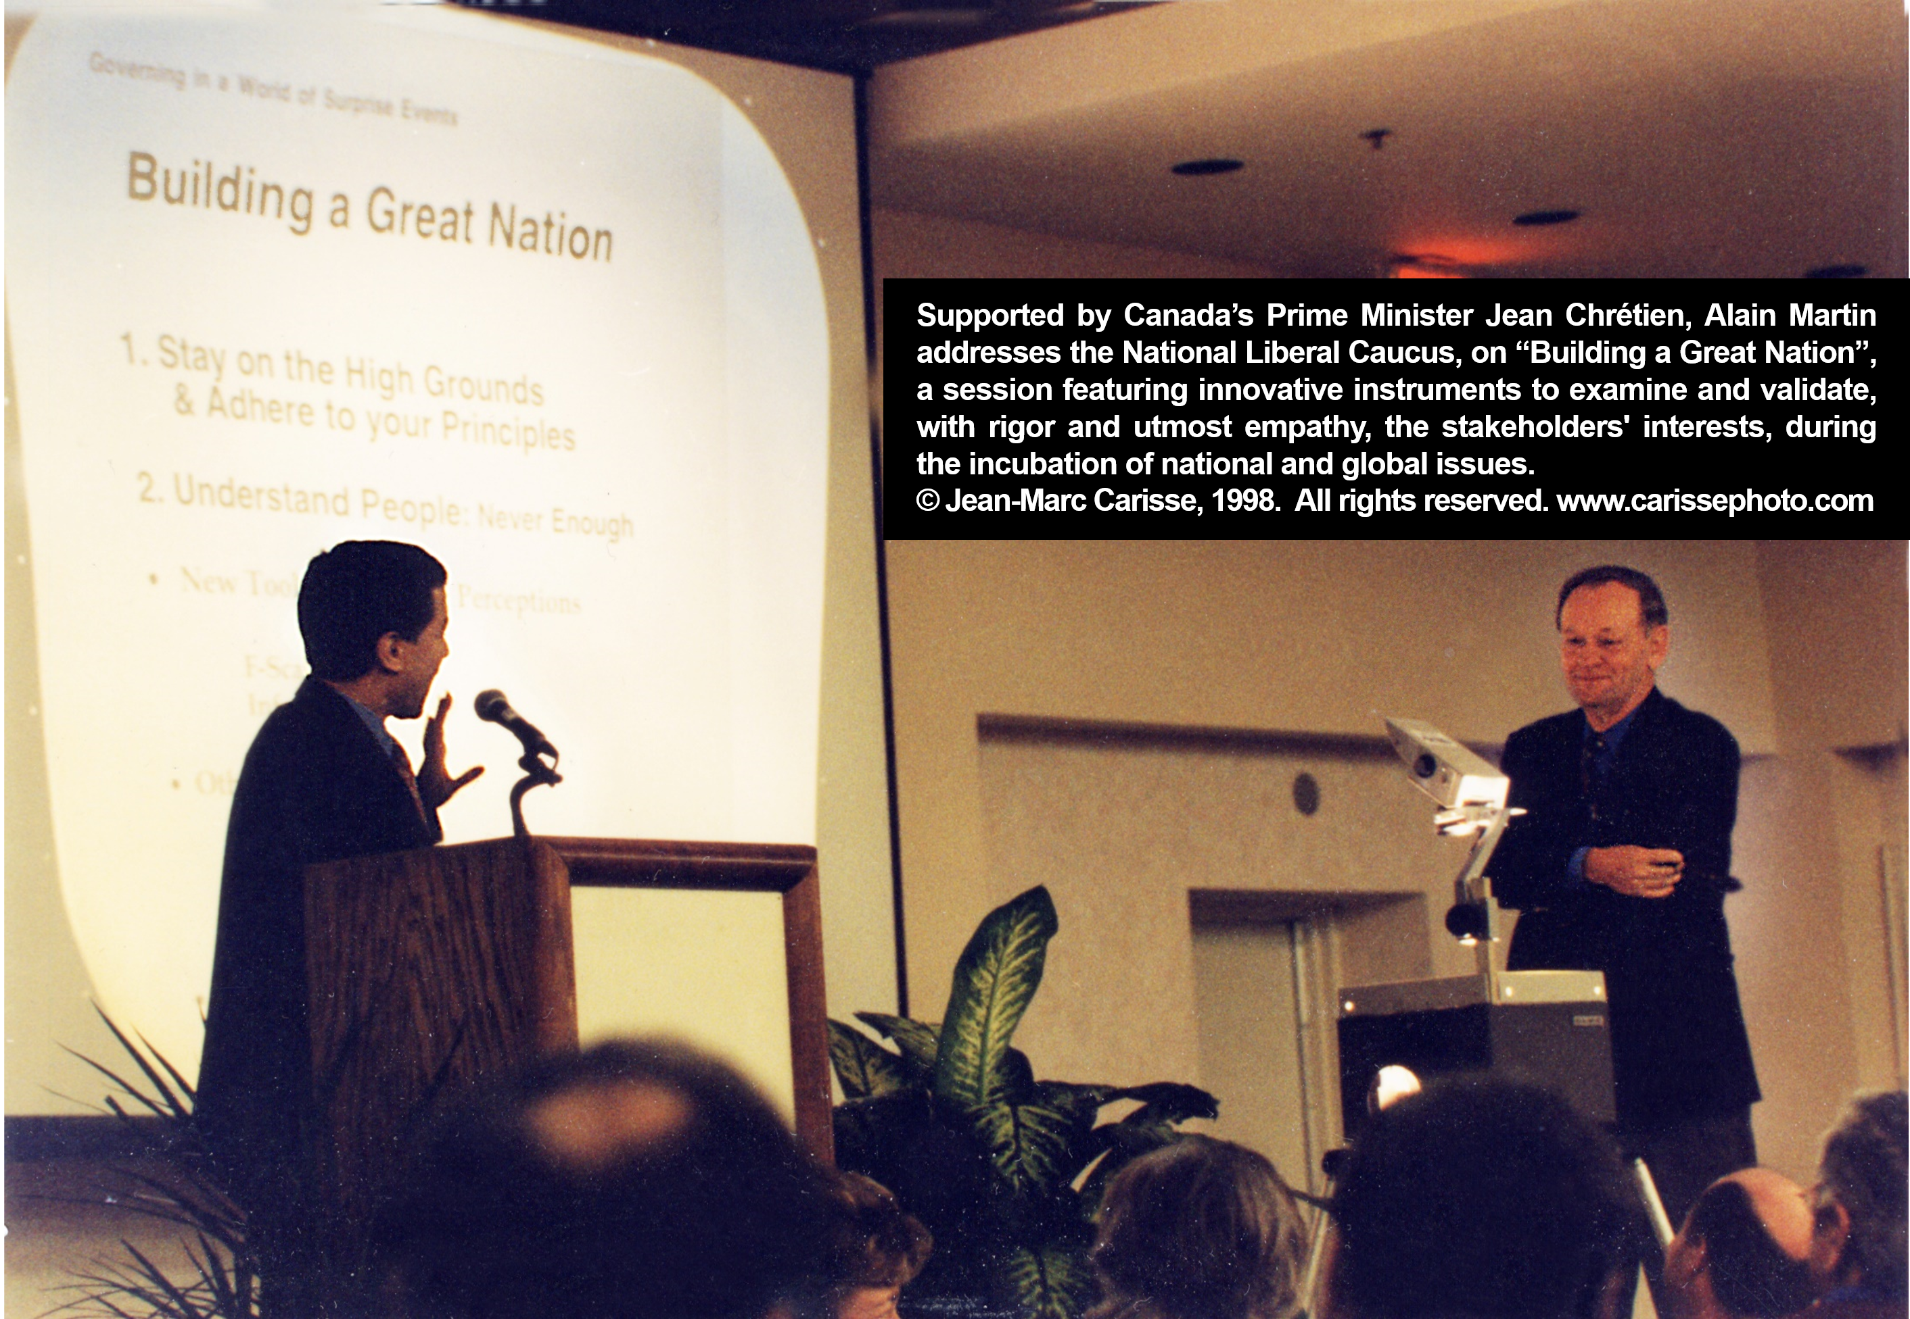
Harvard University Global System™ (HUGS)
Empowering Policy-Makers and Front-Line Public Servants to Excel
Harvard University Global System™ tools work in health protection to address epizootic diseases; incubate the Food Inspection Agency (CFIA); improve highway safety and develop project managers in Defence. In Europe, they served to improve evaluation practices.
As an illustration, we built on the U.K. experience to research, develop and deliver a hands-on workshop to mitigate the risk of mad-cow (BSE) and the new variant Creutzfeldt-Jakob diseases (vCJD), nine months before BSE hit our shores. In the aftermath of that event, we played a role to address the embargo on Canadian meat export to Japan, China and other Asian trade partners: www.eharvard.org/APMartinAdvicesCanadaPM-22K.pdf
Consider our Stakeholders’ Engagement Prism™ to provide insights into the creation of a critical mass for change and collective intelligence to trade; advance scientific research, conflict resolution or lasting peace between employers and unionized employees.
Canada’s Prime Minister Jean Chrétien and Alain Paul Martin
© Jean-Marc Carisse, 1998. All rights reserved. www.carissephotos.com
TM
Harvard University Global System™
The Professional Development Institute® PDI Inc.
www.eharvard.org ● © Alain Paul Martin, 2023. All rights reserved
Notes:
F

Slide 31
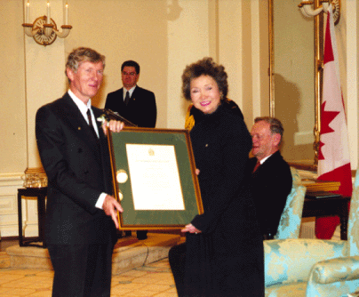
With Gratitude to Dr. Brian Morrissey
We are indebted to Dr. Brian Morrissey who, upon retirement, generously probed the evolution of Bovine Spongiform Encephalopathy (BSE), the human counterpart Variant Creutzfeldt-Jakob disease (vCJD) and related policy reform in the U.K. Armed with U.K. intelligence, Dr. Morrissey wrote a case study applying Harvard University Global System™ tools, notably the issue-incubation framework, published in “Harnessing the Power of Intelligence, Counterintelligence & Surprise Events”. He teamed up with Alain Martin to deliver a hands-on strategy workshop to prepare the executives and senior scientists, responsible to address these epizootic diseases, at the Health-Protection Branch, nine months before BSE hit our shores. Years earlier, he wrote the following to confirm Alain Martin’s contribution to CFIA’s creation:
“Mr. Martin worked directly with me on several management consulting projects, including the design of a new Canadian Food Inspection System. This involved taking a systems approach and integrating crop, animal and food inspection into a seamless food safety system. This work was the initial step in the creation of the current Canadian Food Inspection Agency (CFIA).”
Dr. John Brian Morrissey
Head of Food Inspection for Canada (Retired)
Chief Veterinary Officer for Canada (Retired)
Head of Research for Agriculture Canada (Retired)”
Dr. Brian Morrissey receives Canada’s Public Service
Outstanding Achievement Award, the highest public service commendation, from Governor General Adrienne Clarkson. On the occasion, Prime Minister Jean Chrétien (on the right) said, Dr. Morrissey has "earned the respect of co-workers, the admiration of peers and the gratitude of the nation."
CFIA TODAY: Canada’s largest science-based regulatory agency ● 6,000 employees ● 13 laboratories across Canada
● “food-safety starts with healthy plants and animals to prevent the spread of invasive plants, plant pests, and animal diseases”

Slide 32
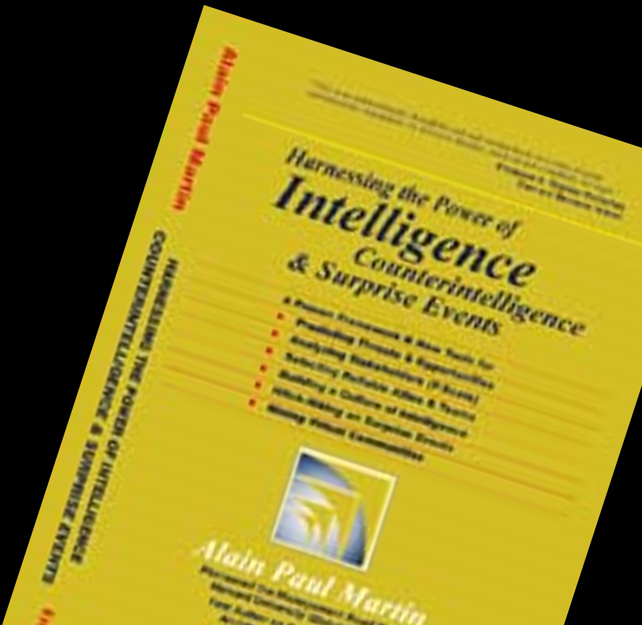
Defense Leaders’ Testimonials
for Martin’s Intelligence Framework
“This book has a range of excellent concepts that are useful to DOD organizations to improve their awareness of internal and environmental factors. This increased awareness
could help leaders anticipate emerging issues and concerns to DOD at large… As we operate in increasingly complex environments, information gathering, synthesizing,
filtering, and distributing are incredibly important organizational tasks. This book helps people think about and approach the complexity and uncertainty organizations face today.”
Col. Robert J. D’Amico
Office of the Chairman of the Joint Chiefs of Staff
US Department of Defense
“Alain Paul Martin has produced a book that allows decision-makers to improve their ability to understand how intelligence professionals link the dots between collection, analysis and interpretation.”
Ray R. Henault, General and Chief of the Defence Staff
Canadian Forces (Retired)
Chairman, NATO’s Military Committee (Retired)
I highly recommend that all managers and leaders read this book with a view to gaining informational insights and practical knowledge that can be applied to either everyday or crisis situations.”
George Kolisnek, Director Strategic Intelligence
Department of National Defence
TM
Harvard University Global System™
The Professional Development Institute® PDI Inc.
www.eharvard.org ● © Alain Paul Martin, 2023. All rights reserved

Slide 33
Presidential, Executive & Administrative Assistants
The previous interview, of Canadian and Finish participants,
was conducted at the end of the Intermediate Workshop.
The next participant was the assistant to the CEO of a multi-billion dollar firm,
when she completed the Intermediate and advanced workshops.
Interviewed in Germany two years afterwards, she describes
the unique contribution of the acquired skills and Harvard® tools,
to her professional accomplishments, career progress,
personal multi-context inelastic-deadlines’ management
and advanced education, including admission to,
and graduation from, a top-ranked MBA program.
TM
Intermediate & Advanced Workshops for Presidential, Executive & Admin. Assistants
Applying Best Practices and Harvard University Global System™ Tools
The Professional Development Institute® PDI Inc.
www.eharvard.org ● © Alain Paul Martin, 2023. All rights reserved

Slide 34
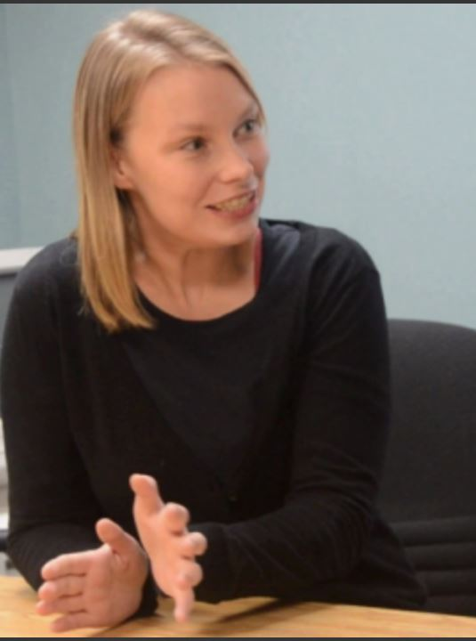
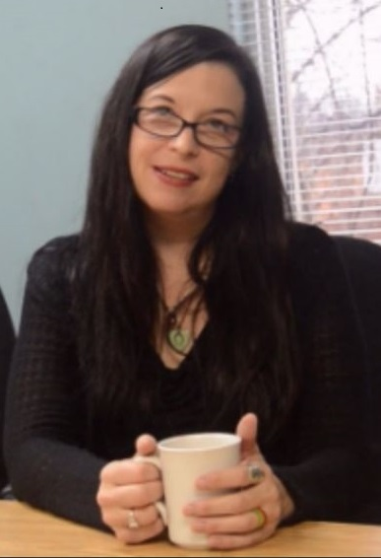
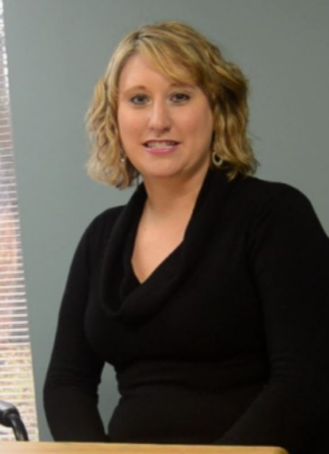
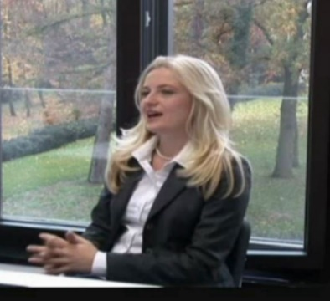
Participants’ Testimonials from Canada, Finland, Germany, the U.S. and South Africa
For Presidential, Executive & Administrative Assistants
Worldwide Certification in Management & Leadership Skills,
Best Practices and Harvard University Global System™ Tools
™
Intermediate & Advanced Workshops in English, French and Spanish
.
Harvard University Global System™ ● The Professional Development Institute® PDI Inc. ● eharvard.org

Slide 35
Giving EAs a Synergistic Voice in Management and Creativity
EAs skilled in Harvard University Global System™ can fully participate in collaborative innovation, negotiations, risk and project management, often the prerogative of scientists, engineers and managers..
Project-management software improved in speed, capacity and look & feel; but professional versions are NOT readily accessible to all team members, whose clients pay a premium on redundant complexity, by relying on project leaders to plan and interpret technical reports. Thus, inclusion, a bedrock of equity, teamwork and innovation, wasn’t a priority for software designers, who made no effort to spare users needless complexity.
Executive and administrative assistants in the public and private sectors participating PDI workshops acquire the practical skills and Harvard® productivity tools to excel in high performance and team synergy.
As we pivot from apps to low and no-code AI agents, empowering EAs with cutting-edge skills is vital to lift all toward an equal playing field. Also, the Harvard® System permits selective critical project communication, across linguistic divides. This is a milestone in our ongoing journey for diversity, universal inclusion and effectiveness by preparing every team member to act as a truly collaborative voice in management and creative tasks.
“Some of our success in becoming a word class manufacturer can be attributed to Alain Martin’s leadership and abilities, both as both as project-management practitioner and instructor...
Companies like PDI... set the highest standards of quality in product and services. I am sure I speak for others at Boeing when I say it is good to have you as an ally.”
Don Mallory, Boeing
TM
Harvard University Global System™
The Professional Development Institute®
www.eharvard.org
.

Slide 36
Harvard University Global System™
A Brief Introduction
TM
Harvard University Global System™
The Professional Development Institute® PDI Inc.
www.eharvard.org ● © Alain Paul Martin, 2023. All rights reserved

Slide 37
User Testimonies’ Summary
Why These Users Opted for HUGS Tools?
The users featured here are diverse and so are the benefits they derived from Harvard® tools as illustrated below.
1. Adopt Harvard® tools in business, social enterprises and government endeavors to excel in decision-making.
• Innovate by applying Harvard® framework and instruments in unconstrained imagination, structured creativity, digital options incl. low and no-code, discovery, sustainability, interoperability, prototyping, testing, scaling and strategic deliveries of worthy products, services, platforms, processes and systems. Stimulate novel choices with less guesswork, in radical multi-billion dollar transformations, as well as in small projects and startups.
• Gain insights into opportunities and threats through stakeholders’ dynamics, unseen and overlooked incubating events and other intelligence.
• Chart the future by facilitating vision, mission and goal-setting, sustainability (decarburization and biodiversity), policy and strategy formulation, principled negotiation; and daring to experiment/risk and fail without the stigma of failure. Execute with the details that count. Chart responsibility. Prevent role conflicts. Tackle inequities. Manage project portfolios. Prepare Succession.
• Facilitate funding, revenue generation and growth through collective intelligence, stakeholders’ empowerment and engagement. Build and retain strategic allies and loyal clients. Gain a sustainable competitive advantage.
• Turn risks into opportunities, where feasible. Mitigate risk. Build contingencies for residual risk.
2. Improve team synergy and effectiveness. Plan and manage personal life and time. Overcome self-inflicted roadblocks.
With Harvard® tools, you can gain insights into the toughest issues;
probe the unseen and the overlooked; and apply collaborative innovation to move forward..
TM
Harvard University Global System™
The Professional Development Institute® PDI Inc.
www.eharvard.org ● © Alain Paul Martin, 2023. All rights reserved

Slide 38

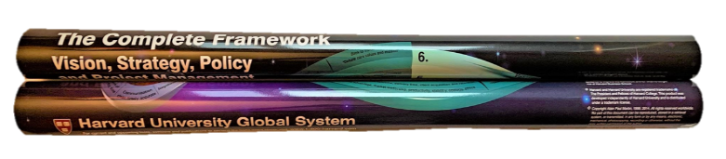
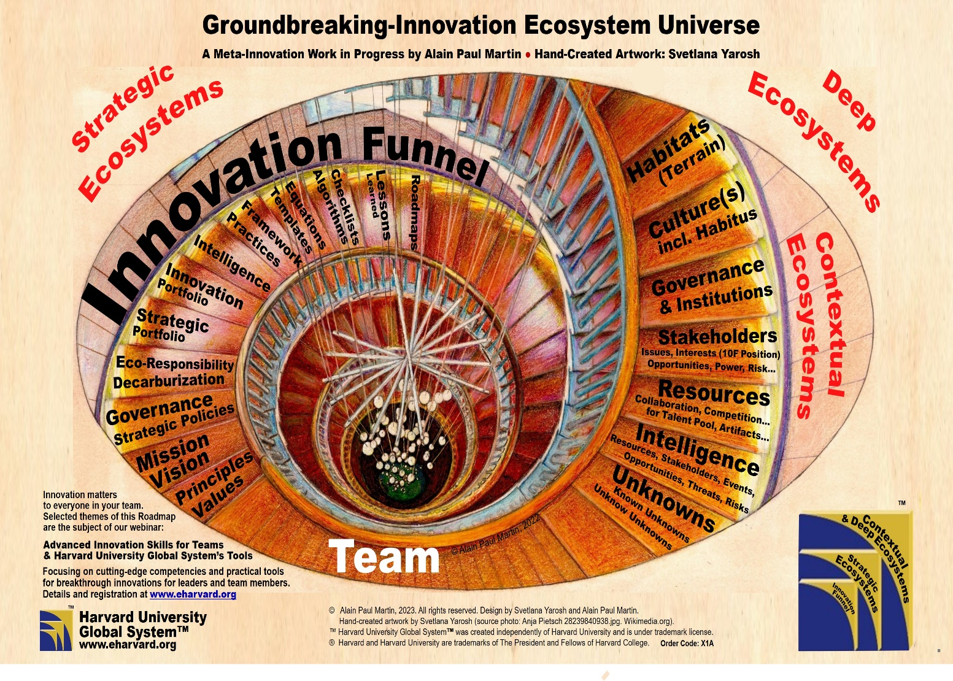
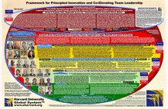
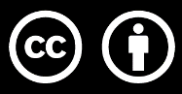
Framework for Principled Innovation
and Co-Elevating Team Leadership
This framework is largely about asking
pertinent questions. It supports all
phases of the innovation funnel, from
ideation to exploratory and structured creativities to invention, development, scaling, commercialization, adoption,
(or diffusion) and renewal.
Harvard University Global System™ comprises
a practical toolkit of principles, roadmaps, templates,
equations and algorithms, not shown here.
TM
Harvard University Global System™
North America: Toll Free: 1-800-HARVARD or +1 819 772-7777
Europe : +33 7 68 47 23 11 ● rsvp@eharvard.org
© Alain Paul Martin, 2023. All rights reserved.
We train trainers and license users.
Oval colorful-background source: Elongated circle at:
commons.Wikimedia.org/wiki/File:Gradient_color_wheel.png

Slide 39
The Foundations of Harvard® Innovation Framework
Innovation starts with Curiosity and Imagination
What Is Imagination?
“Logic will get you from A to B.
Imagination?
Logic
Imagination will take you everywhere.” *
A
A
B
Albert Einstein
∞
                * In tribute to mathematician Emmy Noether’s groundbreaking research
                proving that time symmetry is related to conservation of energy.
1. Is Einstein’s celebrated quotation incomplete? Why or why not?
2. What risks does it pose to innovation?
TM
Harvard University Global System™
The Professional Development Institute® PDI Inc.
www.eharvard.org ● © Alain Paul Martin, 2023. All rights reserved

Slide 40
Going Beyond Einstein’s Quotation
“Logic will get you from A to B. Imagination will take you everywhere.”
Albert Einstein
Q: Is above quotation Incomplete? Why/why not? What risks does It pose to innovation?
A: We actually need both imagination and logic in an iterative fashion.
Thus, Einstein’s quotation applies only to one phase of innovation namely:
Phase II: Exploratory Creativity
to Unleash Unconstrained, Unfiltered Wide & Inclusive Imagination and Cross-Pollination of Ideas”.
But without a flexible and constantly probed logic (framework, process, method, practices), viable options tend to be overlooked. In our innovation framework, Phase 3’s Structured-Creativity, together with iterations, often lead to better choices and less guesswork.
Options neglected in other methodologies tend to emerge, as Dr. Rob Stephens confirmed earlier, in this video, by providing illustrations from energy, mining and advanced-materials industries.
TM
Harvard University Global System™
The Professional Development Institute® PDI Inc.
www.eharvard.org

Slide 41
Worthwhile to Keep in Mind
“Complexity is not an option if we cannot ascertain,
at least indirectly, with high confidence,
its foundation on visible or even invisible modular simplicity.”
Jean Perrin
Adapted from Nobel Laureate Jean Perrin’s statement about the ultimate goal
of science namely to “Substitute visible complexity for an invisible simplicity”.
Simplicity by choice; complexity by necessity.
Alain Paul Martin
“Perfection cannot be achieved when there is nothing to add,
but when there is nothing left to take away.”
Antoine de Saint-Exupéry
TM
Harvard University Global System™
The Professional Development Institute® PDI Inc.
www.eharvard.org ● © Alain Paul Martin, 2023. All rights reserved

Slide 42
Harvard University Global System™
The new value-chain
is the construct behind
our complete framework
TM
Harvard University Global System™
The Professional Development Institute® PDI Inc.
www.eharvard.org ● © Alain Paul Martin, 2023. All rights reserved

Slide 43
Innovation Cycle: Core Tasks
Imagine
Validate goals & Context. Make assumptions explicit.
Imagine (free-flow of ideas). Brainstorm to Improve on ideas.
Test. Reframe. Digitize. Iterative creativity rounds.
Invent
Going Beyond
Einstein’s Quotation
Discover. Partner. Experiment.
Crowdsource. Outsource. Reframe.
In some cases, Skip this phase.
Develop
Deliver. Evaluate.
Iterate to upgrade.
Renew.
TM
Harvard University Global System™
The Professional Development Institute® PDI Inc.
www.eharvard.org ● © Alain Paul Martin, 2023. All rights reserved

Slide 44
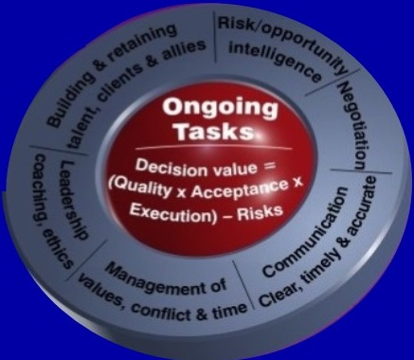

Slide 45
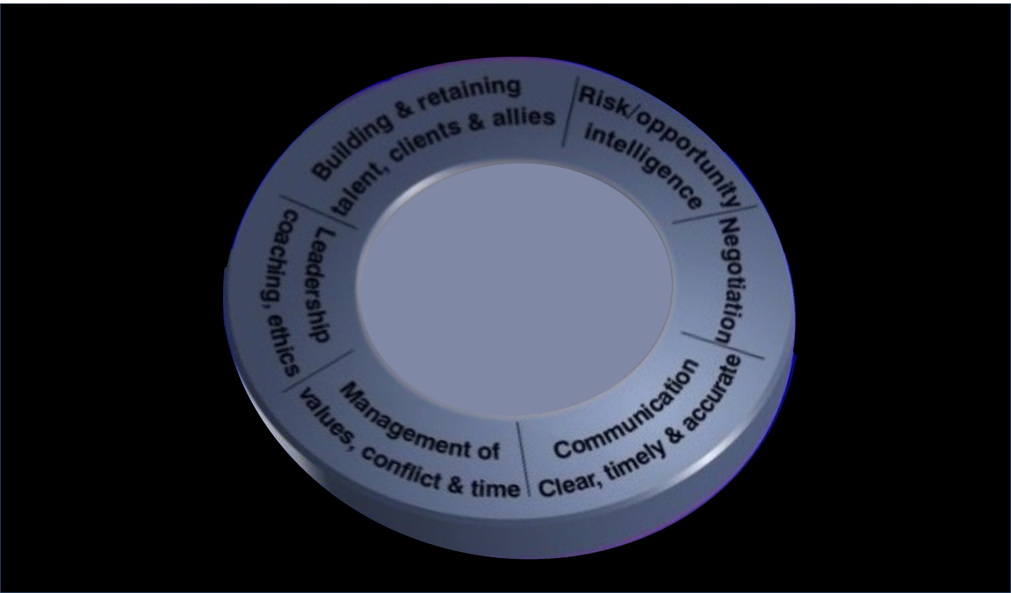
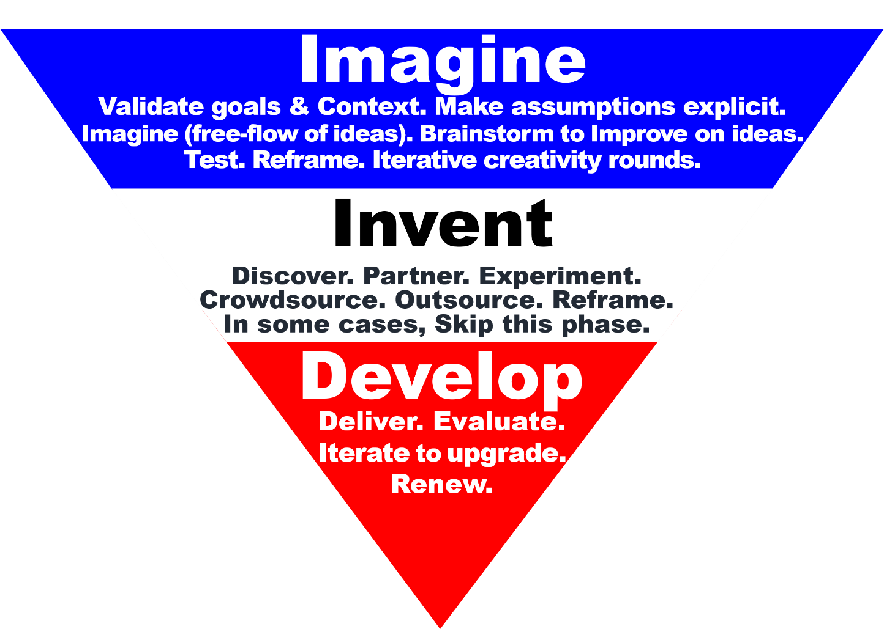
Innovation-Process Ecosystem
Leadership
Governance
Culture
TM
Harvard University Global System™
The Professional Development Institute® PDI Inc.
www.eharvard.org ● © Alain Paul Martin, 2023. All rights reserved

Slide 46
Building on Porter’s, Rayport’s and Sviokla’s Heritage
in a Large Financial Conglomerate
2. THE INNOVATION FUNNEL:
AN ILLUSTRATION of “INVENTION”,
THE FIRST VARIABLE of THE FUNNEL
Desjardins
At Desjardins, we built on Porter’s concept of primary and supporting activities
in the value-creation and extraction phases, by developing a library of decision-support
instruments and differentiating between ongoing activities (leadership, intelligence, communications,
time and risk management, building and retaining talent, clients and allies), and sequential-iterative tasks
(strategic and operational planning, integration with partners and supply-chain work and roll-out). Desjardins
provided the proving grounds to anchor the emerging value-incubation framework in a competitive-advantage focus.
With the benefit of a 10-year lens, Mr. John Harbour confirmed how this framework was among the key tools applied to
support Desjardins build a high-performing organization and consolidate its leading competitive position. Later, as SAAQ’s
CEO for five years, Mr. Harbour’s team applied the framework to save thousands of lives and eliminate a $486-million deficit.
Subsequent assignments with government heads, policy makers and Procter & Gamble made it possible
to expand the framework from value to issue incubation; thus encompassing both opportunities and
threats in the physical and virtual realms. The Global framework’s performance-improvement
instruments are currently available under the trademark: Harvard University Global System™.
TM
Harvard University Global System™
The Professional Development Institute® PDI Inc.
www.eharvard.org ● © Alain Paul Martin, 2023. All rights reserved

Slide 47
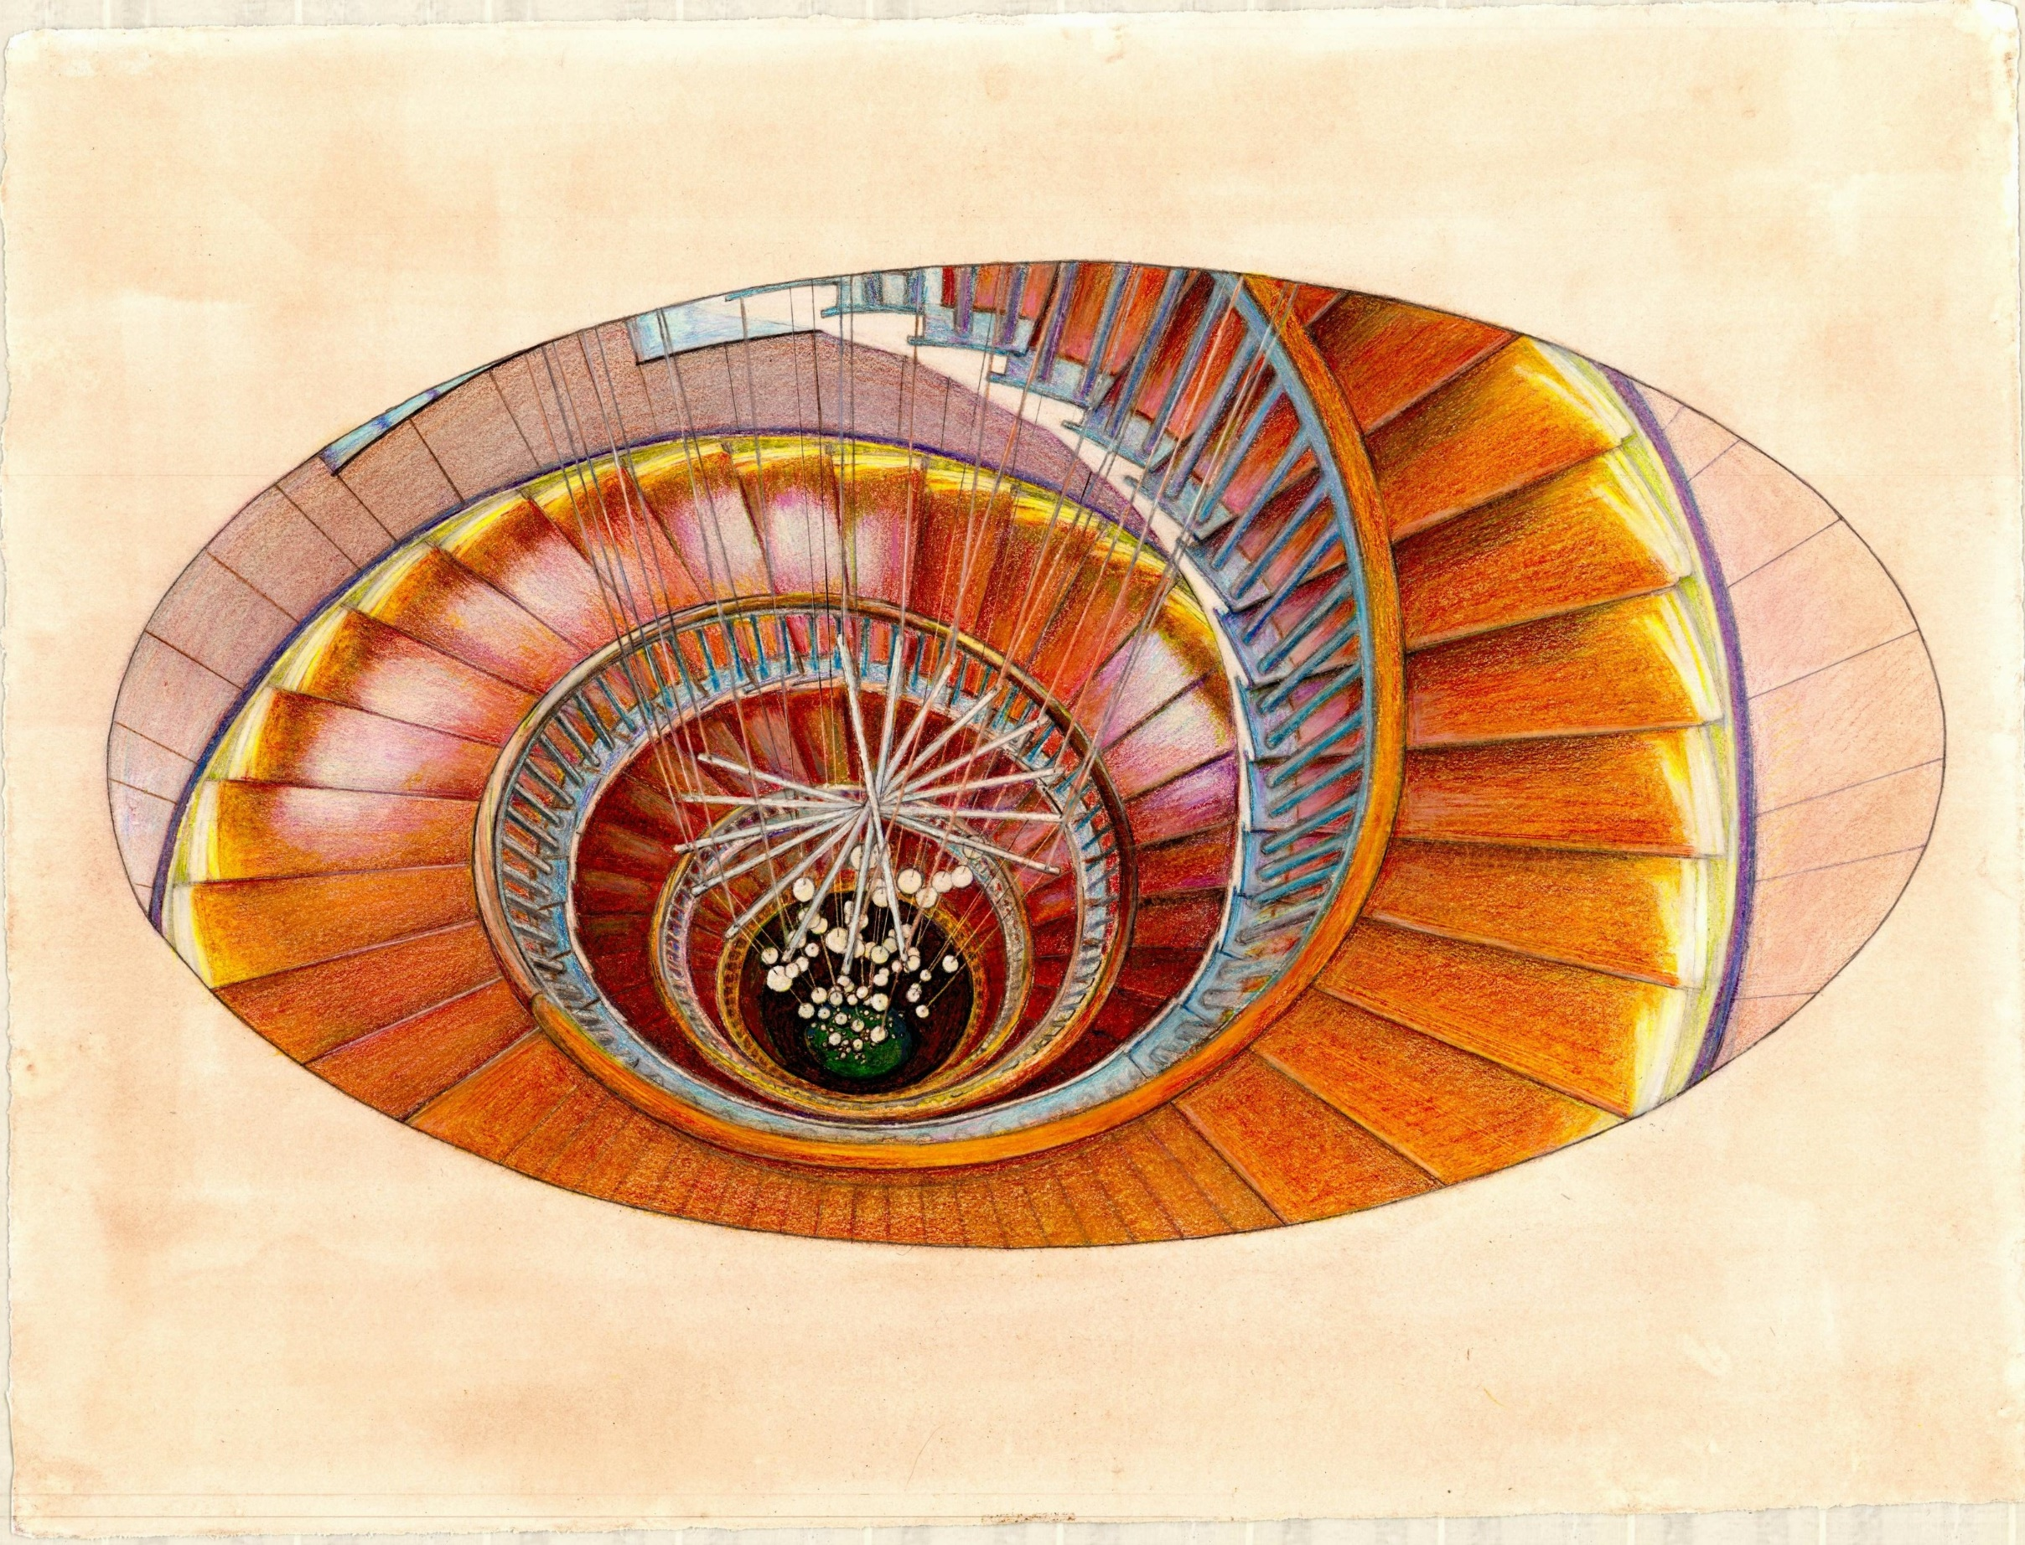
Groundbreaking-Innovation Ecosystem Universe
A Meta-Innovation Work in Progress by Alain Paul Martin ● Hand-Created Artwork: Svetlana Yarosh
Strategic
Deep
Ecosystems
Ecosystems
Contextual
Ecosystems

Slide 48


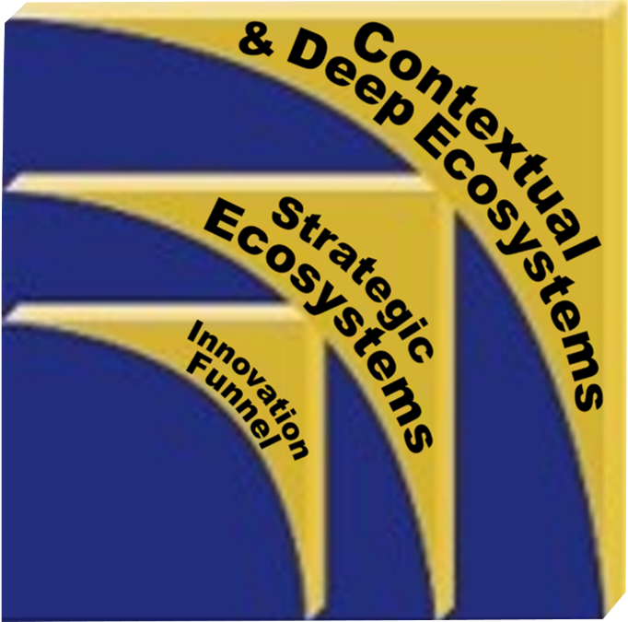
Groundbreaking-Innovation Ecosystem Universe
A Meta-Innovation Work in Progress by Alain Paul Martin ● Hand-Created Artwork: Svetlana Yarosh
Deep
Strategic
Ecosystems
Habitats
Ecosystems
o
(Terrain)
tion
n
n
v
a
Lessons
Culture(s)
Checklists
Algorithms
Next Slide
Equations
Learned
Roadmaps
Templates
F
F
incl. Habitus
unnel
unnel
Framework
Practices
Contextual
Ecosystems
Intelligence
Governance
Innovation
Portfolio
& Institutions
Strategic
Portfolio
Stakeholders
Eco-Responsibility
Issues, Interests (10F Position)
Decarburization
Opportunities, Power, Risk…
Resources
Governance
Collaboration, Competition…
Strategic Policies
for Talent Pool, Artifacts…
Mission
Intelligence
Vision
Resources, Stakeholders, Events,
Principles
Opportunities, Threats, Risks
Innovation matters
to everyone in your team.
Selected themes of this Roadmap
are the subject of our webinar:
Values
© Alain Paul Martin, 2022
Unknowns
™
Known Unknowns
Unknow Unknowns
Advanced Innovation Skills for Teams
& Harvard University Global System’s Tools
Team
Focusing on cutting-edge competencies and practical tools for breakthrough innovations for leaders and team members. Details and registration at www.eharvard.org
™
Harvard University
Global System™
© Alain Paul Martin, 2023. All rights reserved. Design by Svetlana Yarosh and Alain Paul Martin.
Hand-created artwork by Svetlana Yarosh (source photo: Anja Pietsch 28239840938.jpg. Wikimedia.org).
™ Harvard University Global System™ was created independently of Harvard University and is under trademark license.
® Harvard and Harvard University are trademarks of The President and Fellows of Harvard College.
www.eharvard.org
Order Code: X1A

Slide 49
Groundbreaking-Innovation Ecosystem Universe
A Meta-Innovation Work in Progress by Alain Paul Martin ● Hand-Created Artwork: Svetlana Yarosh
Deep
Strategic
Ecosystems
Habitats
Ecosystems
o
(Terrain)
tion
n
n
v
a
Lessons
Culture(s)
Checklists
Algorithms
Equations
Learned
Roadmaps
Templates
F
F
incl. Habitus
unnel
unnel
Framework
Practices
Contextual
Ecosystems
Intelligence
Governance
Innovation
Portfolio
& Institutions
Strategic
Portfolio
Stakeholders
Eco-Responsibility
Issues, Interests (10F Position)
Decarburization
Opportunities, Power, Risk…
Resources
Governance
Collaboration, Competition…
Strategic Policies
for Talent Pool, Artifacts…
Mission
Intelligence
Vision
Resources, Stakeholders, Events,
Principles
Opportunities, Threats, Risks
Innovation matters
to everyone in your team.
Selected themes of this Roadmap
are the subject of our webinar:
Values
© Alain Paul Martin, 2022
Unknowns
™
Known Unknowns
Unknow Unknowns
Advanced Innovation Skills for Teams
& Harvard University Global System’s Tools
Team
Focusing on cutting-edge competencies and practical tools for breakthrough innovations for leaders and team members. Details and registration at www.eharvard.org
™
Harvard University
Global System™
© Alain Paul Martin, 2023. All rights reserved. Design by Svetlana Yarosh and Alain Paul Martin.
Hand-created artwork by Svetlana Yarosh (source photo: Anja Pietsch 28239840938.jpg. Wikimedia.org).
™ Harvard University Global System™ was created independently of Harvard University and is under trademark license.
® Harvard and Harvard University are trademarks of The President and Fellows of Harvard College.
www.eharvard.org
Order Code: X1A

Slide 50
HUGS
Innovation Framework
Both in continuous improvement
and radical transformations, our framework
(principles, roadmaps, templates, equations, algorithms)
supports all phases of the innovation funnel, from ideation and
invention to development, commercialization, scaling
and adoption (or diffusion) and renewal.
TM
Harvard University Global System™
The Professional Development Institute® PDI Inc.
www.eharvard.org ● © Alain Paul Martin, 2023. All rights reserved

Slide 51
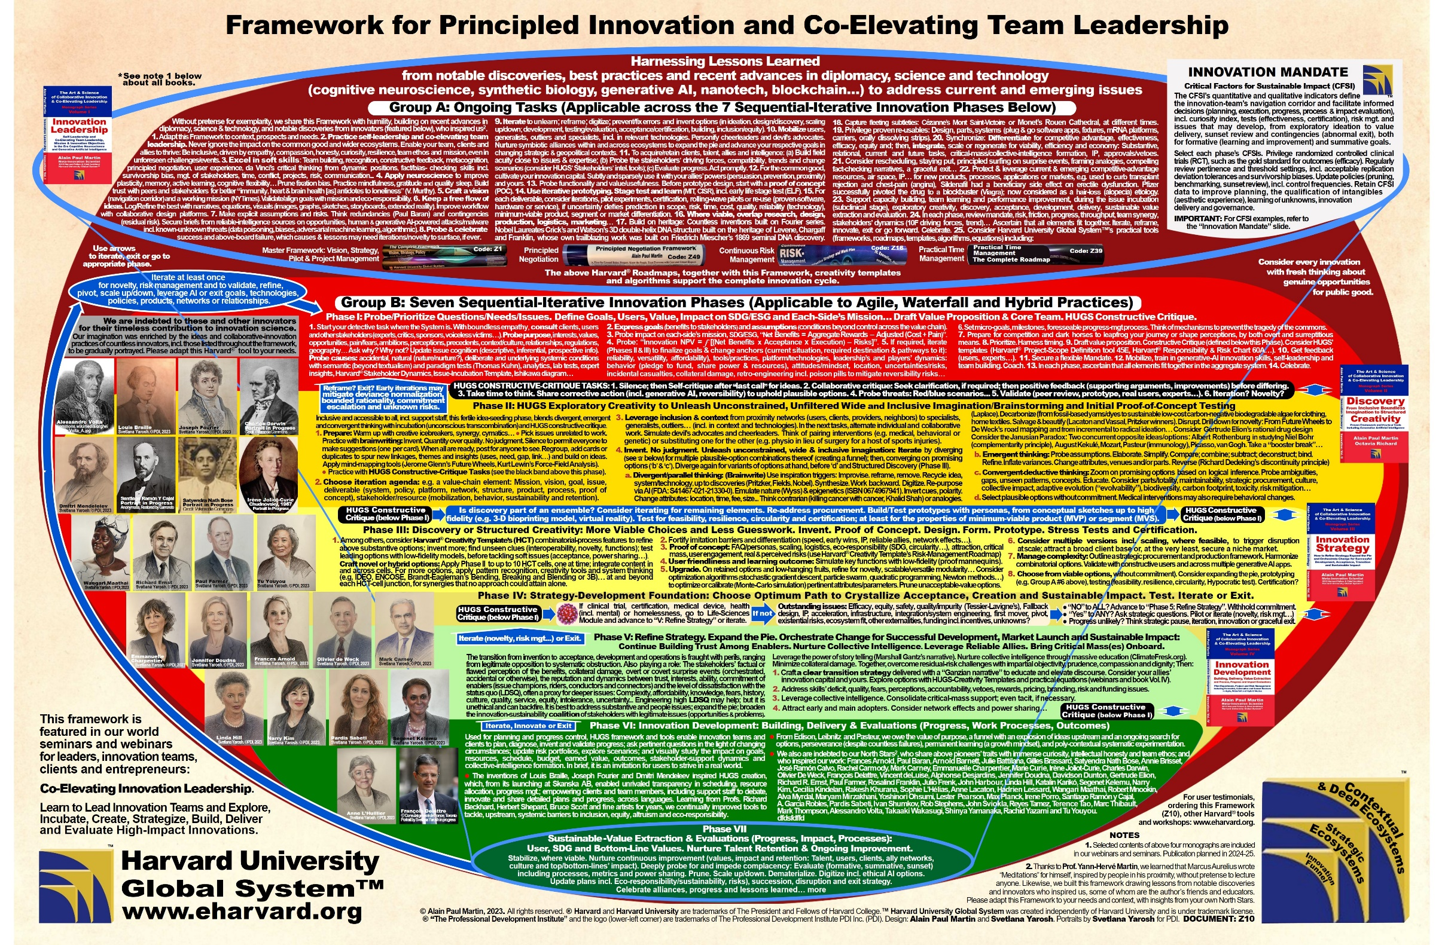

.

Slide 52
Framework for
Principled Innovation and
Co-Elevating Team Leadership
Applying Innovation Science, Cognitive Neuroscience, Psychology,
Generative AI, Eco-Responsibility’s Best Practices and
Harvard University Global System™ (HUGS) Tools
.

Slide 53
The Spirit of Innovation
Prof. Pardis Sabeti’s following insights
inspire us to work in harmony, beyond the world of pathogens,
in the spirit of principled collaborative and co-elevating innovation.
“While we fight among ourselves, the virus thrives…
We [have] to work openly, we [have] to share and we [have] to work together…
Let us not let the world be defined by the destruction wrought by one virus
[or conflict], but illuminated by billions of hearts and minds working in unity.”
Adapted excerpts from Prof. Pardis Sabeti TEDWomen 2015,
“How we'll fight the next deadly virus.”
TM
Testimonials from Users
Harvard University Global System™
The Professional Development Institute® PDI Inc.
www.eharvard.org ● © Alain Paul Martin, 2023. All rights reserved

Slide 54
The Global Method™ and
Harvard University Global System™
8. Personal Time and
Quality of Life Management
Roadmap and Harvard®
Planners & Organizers
TM
Harvard University Global System™
The Professional Development Institute® PDI Inc.
www.eharvard.org ● © Alain Paul Martin, 2023. All rights reserved

Slide 55
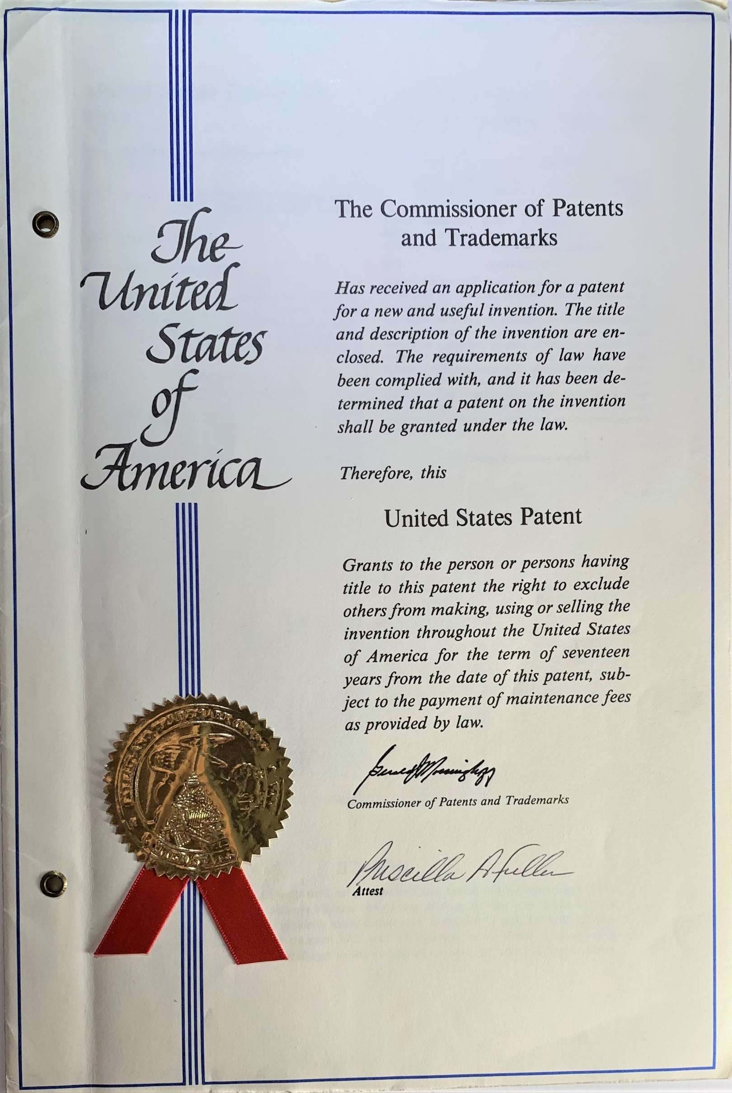
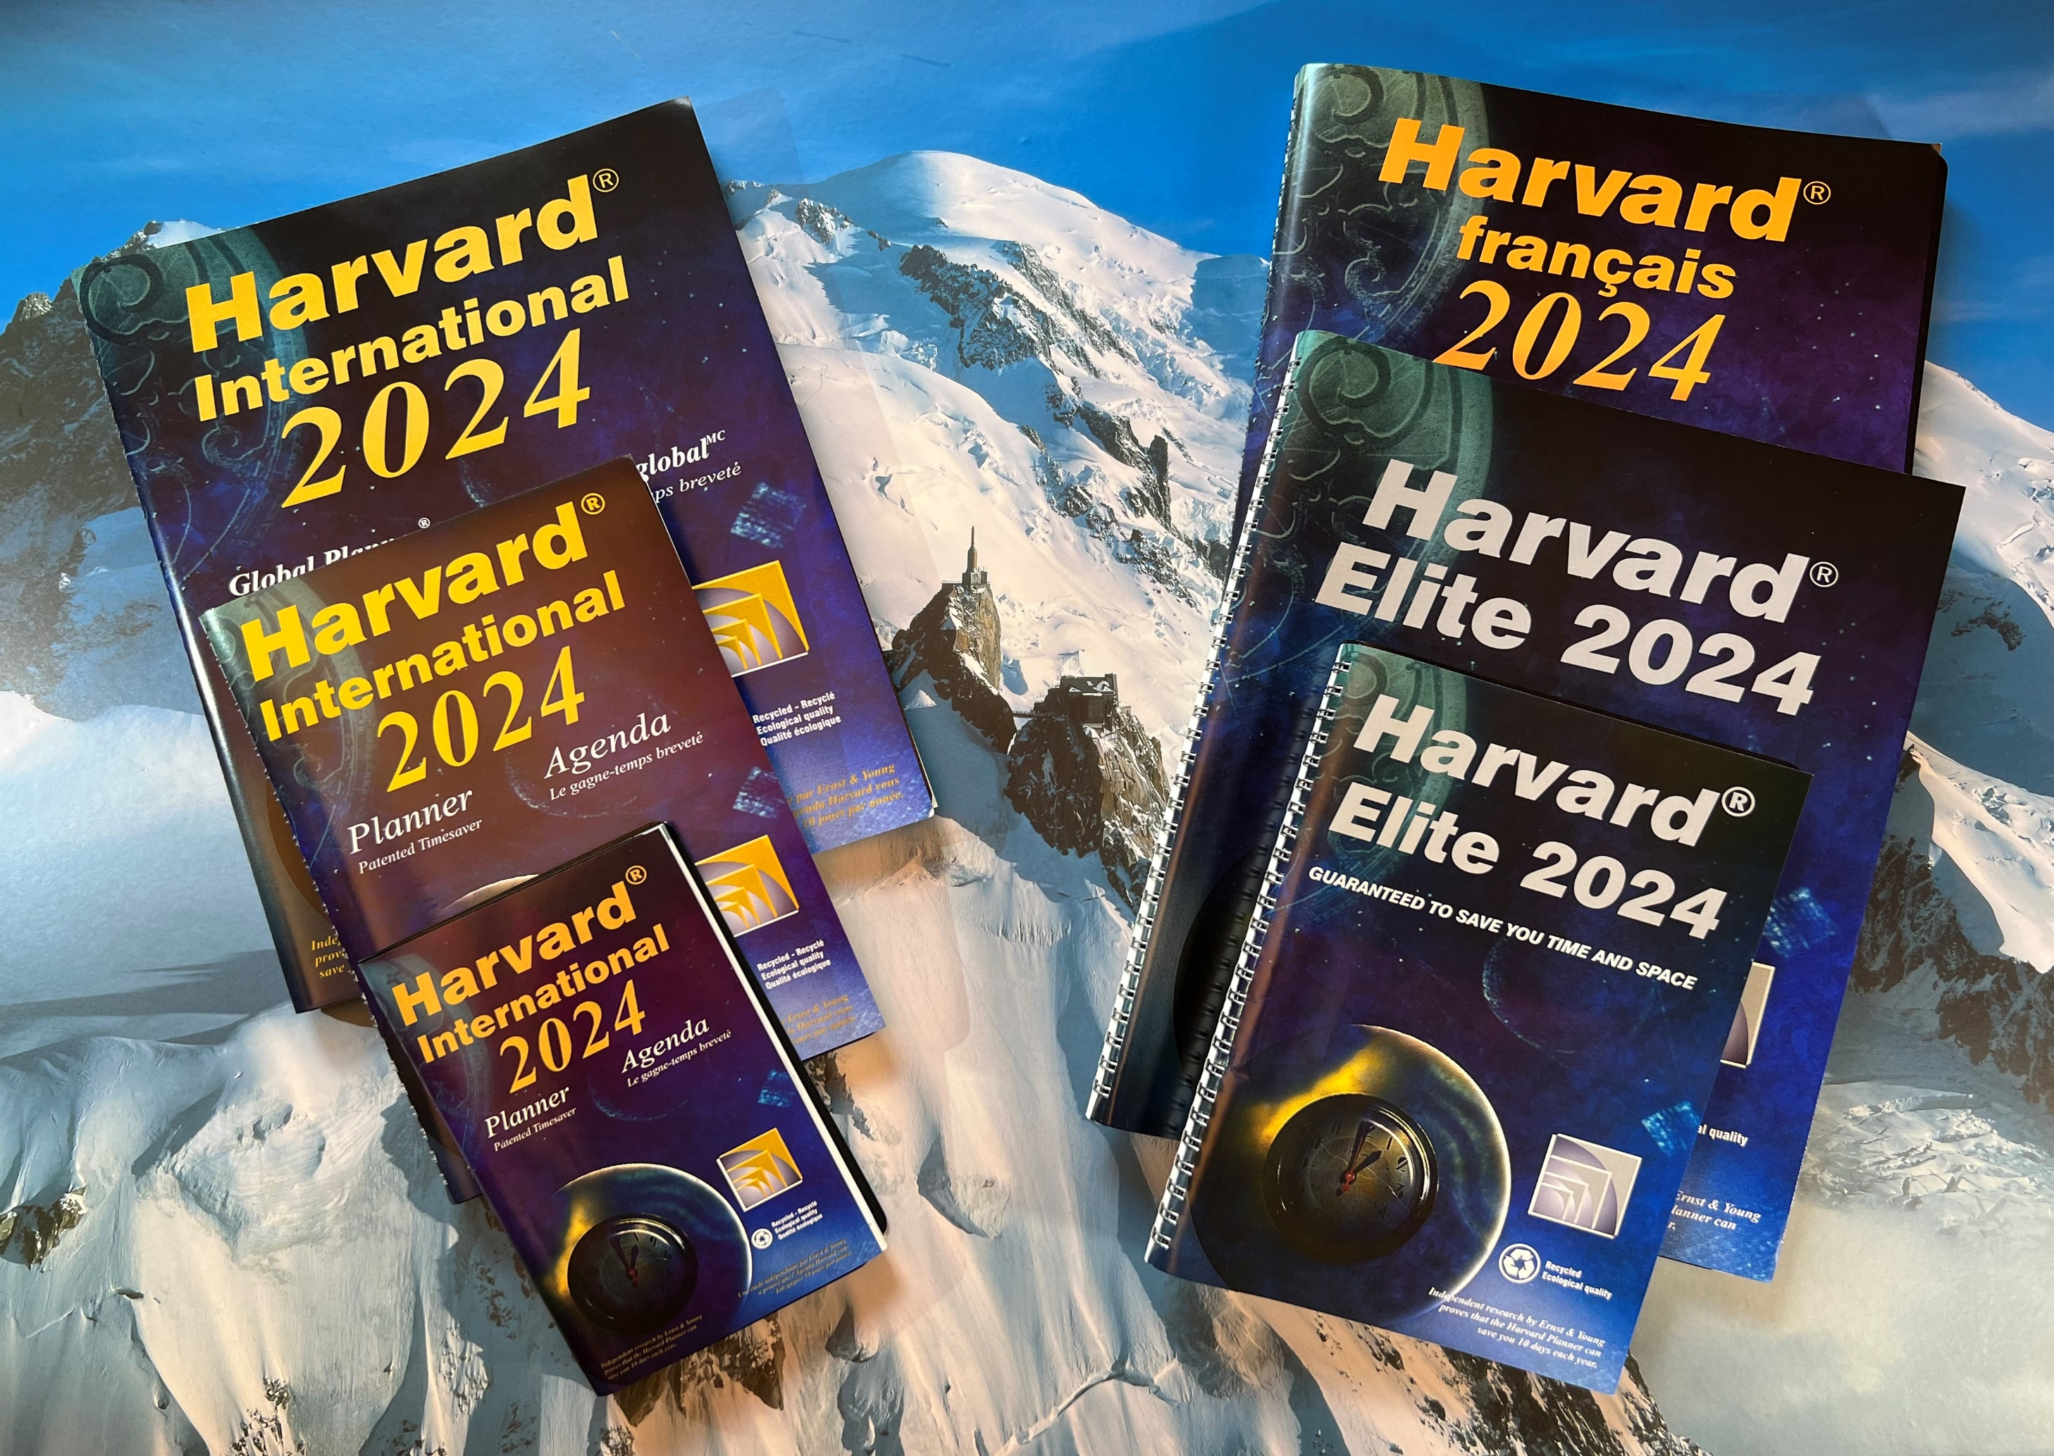


The Harvard® Planner: A Genuine Quality-of-Life Invention with Users on Every Continent
Saves You Space and 10 Days a Year Over Its Counterparts* and Much More — Guaranteed!
A Leading Ecofriendly Paper-Based Time-Management Planner**
* Based on Ernst & Young independent assessment (eharvard.org/info/ernst.asp)
** The patented rescheduling without rewriting feature makes it possible to use a smaller-size planner; thus saving space and paper.

Slide 56

Harvard® Planners and Organizers: A Patented Invention
Outperforming the Competition in Space and Timesaving
Give the Gift of Time and Quality of Life to Your Team, Clients
and Friends and Contribute to a Worthy Cause!
● By buying a Harvard® Planner or a refillable genuine-leather Organizer, you are getting the best and proven space and time-saving instrument and contributing to a worthy cause: inclusion in education. Harvard University receives a royalty exclusively for student scholarships.
● The Planner/Organizer is a genuine patented innovation. It outperforms Day-Timers®, Franklin-Covey® and Quo-Vadis® in space, timesaving and customization: You can reschedule without rewriting details about tasks and plan at least 10 events an hour, without cluttering the next time.
● The Harvard® Planner (or Organizer) is your dashboard to planning your life and promptly tracking progress, including virtual teamwork; thanks to practical strategic and day-to-day decision-support tools, for both personal growth and team synergy, e.g. Harvard® Professional Mission & Quality-of-Life Time Log (Timelog35A.asp) and Harvard® Practical Time-Management Roadmap (see next slide).
Harvard® Organizers in Leather Portfolios
Refillable, in desk, intermediate and pocket sizes. Available in English, French and bilingual versions, incl. a genuine-leather portfolio, a Planner, a ruler-page finder, a slim portable punch and laminated tabs to quickly access the different sections. Two pages/week. Columns for priority, delegation, rescheduling, role + pages for yearly and monthly goals, meetings, notes and more.
www.eharvard.org/Planners
TM
Harvard University Global System™
The Professional Development Institute® PDI Inc.
www.eharvard.org ● © Alain Paul Martin, 2023. All rights reserved

Slide 57

© Alain Paul Martin, 2022
All rights reserved.
www.eharvard.org
TM

Slide 58
2. THE INNOVATION FUNNEL:
AN ILLUSTRATION of “INVENTION”,
THE FIRST VARIABLE of THE FUNNEL
The Complete Innovation Cycle
Hybrid Professional Development for
Project Leaders, Scientists, Engineers,
Executive Assistants & Other Team Members
Advanced-Innovation Skills for Teams
Intensive Workshops and Webinars Featuring Theory & Proven Practices
Applying Harvard® Innovation Roadmaps and Templates
Led by Award-Winning Innovators in Scientific, Engineering
and Social Innovations and Complex Change
Details and Registration:
www.eharvard.org/innovation
TM
Harvard University Global System™
The Professional Development Institute® PDI Inc.
www.eharvard.org ● © Alain Paul Martin, 2023. All rights reserved

Slide 59
Public and In-house Webinars and Workshops
Applying Harvard University Global System™
Exclusive Certification in English, French and Spanish
for Leaders, Scientists, Engineers, Executive Assistants and Other Professionals
The Complete Innovation Cycle: Advanced-Innovation Skills for Teams
Exemplary Leadership for Team Leaders – Intermediate and Advanced Sessions
Leadership and Management Skills for New Managers, Team and Project Leaders
Securing the Stakeholders’ Engagement and Building a Sustainable Relationship
Leadership and Management Skills for Presidential, Executive and Administrative Assistants
The Complete Project Management Cycle
Principled Negotiation Skills
Prerequisites and Strategies for Career Success: How to Aim High and Succeed, Regardless of Your Choice
TM
The Professional Development Institute PDI Inc.
Canada, USA : 1-800-HARVARD or 819-772-7777
Europe : +33 7 68 47 23 11 International : +1 819 772-7777
www.eharvard.org

Slide 60
Intellectual-Property Recognition and Attributions with Our Thanks
® Harvard and « Harvard University » are registered trademarks of The President and Fellows of Harvard College.
™ Harvard University Global System™ was created independently of Harvard University and is under trademark license.
The trademarks of The Professional Development Institute PDI Inc. (PDI) are:
− The Professional Development Institute®
− Institut supérieur de gestion™
− Stakeholder-Engagement Prism™
− PDI logotypes (with 3 and 4 arrows pointing Nort-East) including the one below
Our deep gratitude to Mr. Jean-Marc Carisse for the images in Slides 28-29 featuring P.M. Jean Chrétien and Alain Martin.
IMAGES (reference numbers in Slide 2): The following photographers’ work was used under Creative Commons licenses, with deep gratitude:
1. Canadian Parliament’s Peace Tower (cropped). Author: Ducrocq. www.executive.org
2. Statue of Liberty (cropped). Author: William Warby. https://commons.wikimedia.org/wiki/File:Statue_of_Liberty_2007.jpg
3. Torres Mayor, Reforma & BBVA Bancómer buildings (cropped). Author: Keizers. https://commons.wikimedia.org/wiki/File:MEX3.jpg
4. IMF Flag wreath: IMF Family. Author: Babelia. https://commons.wikimedia.org/wiki/File:IMF_family.png
5. Eiffel Tower wearing Europe colors - panoramio.jpg (cropped). Author: Pascal Terjan.
https://commons.wikimedia.org/wiki/File:Eiffel_Tower_wearing_Europe_colors_-_panoramio.jpg
6. London’s Gherkin at Night (cropped). Author: CGP Grey. https://commons.wikimedia.org/wiki/File:The_Gherkin_at_Night_5083530806.jpg
7. Premier Tower Melbourne 2.jpg (cropped). Author: Adrian P Lim.
https://commons.wikimedia.org/wiki/File:Premier_Tower_Melbourne_2.jpg
8. Background image: BlankMap-World-1920.png (cropped). Authors: Spesh531 and Vardion.
https://upload.wikimedia.org/wikipedia/commons/f/f0/BlankMap-World-1920.png
™
The Professional Development Institute PDI Inc.
Toll Free : 1-800-HARVARD • +1 819 772-7777
Europe : +33 7 68 47 23 11
www.eharvard.org

Slide 61
English-Video End
Thank you
for taking precious time to learn about us
and Harvard University Global System™.
Please visit www.eharvard.org or contact us at:
rsvp@eharvard.org or 1-800-HARVARD (+1-819-772-7777)
Register at www.eharvard.org to Martin’s free webinar: The Stakeholders’ Engagement Prism™
Our gratitude to “VMAX Music Album” audio library for the background music
titled: Free no copyright classical music - Best of Chopin (2020),
YouTube’s VMAX Channel at https://youtu.be/w43GrnwZetE.
TM
Harvard University Global System™
The Professional Development Institute® PDI Inc.
www.eharvard.org ● © Alain Paul Martin, 2023. All rights reserved

